Slide 1
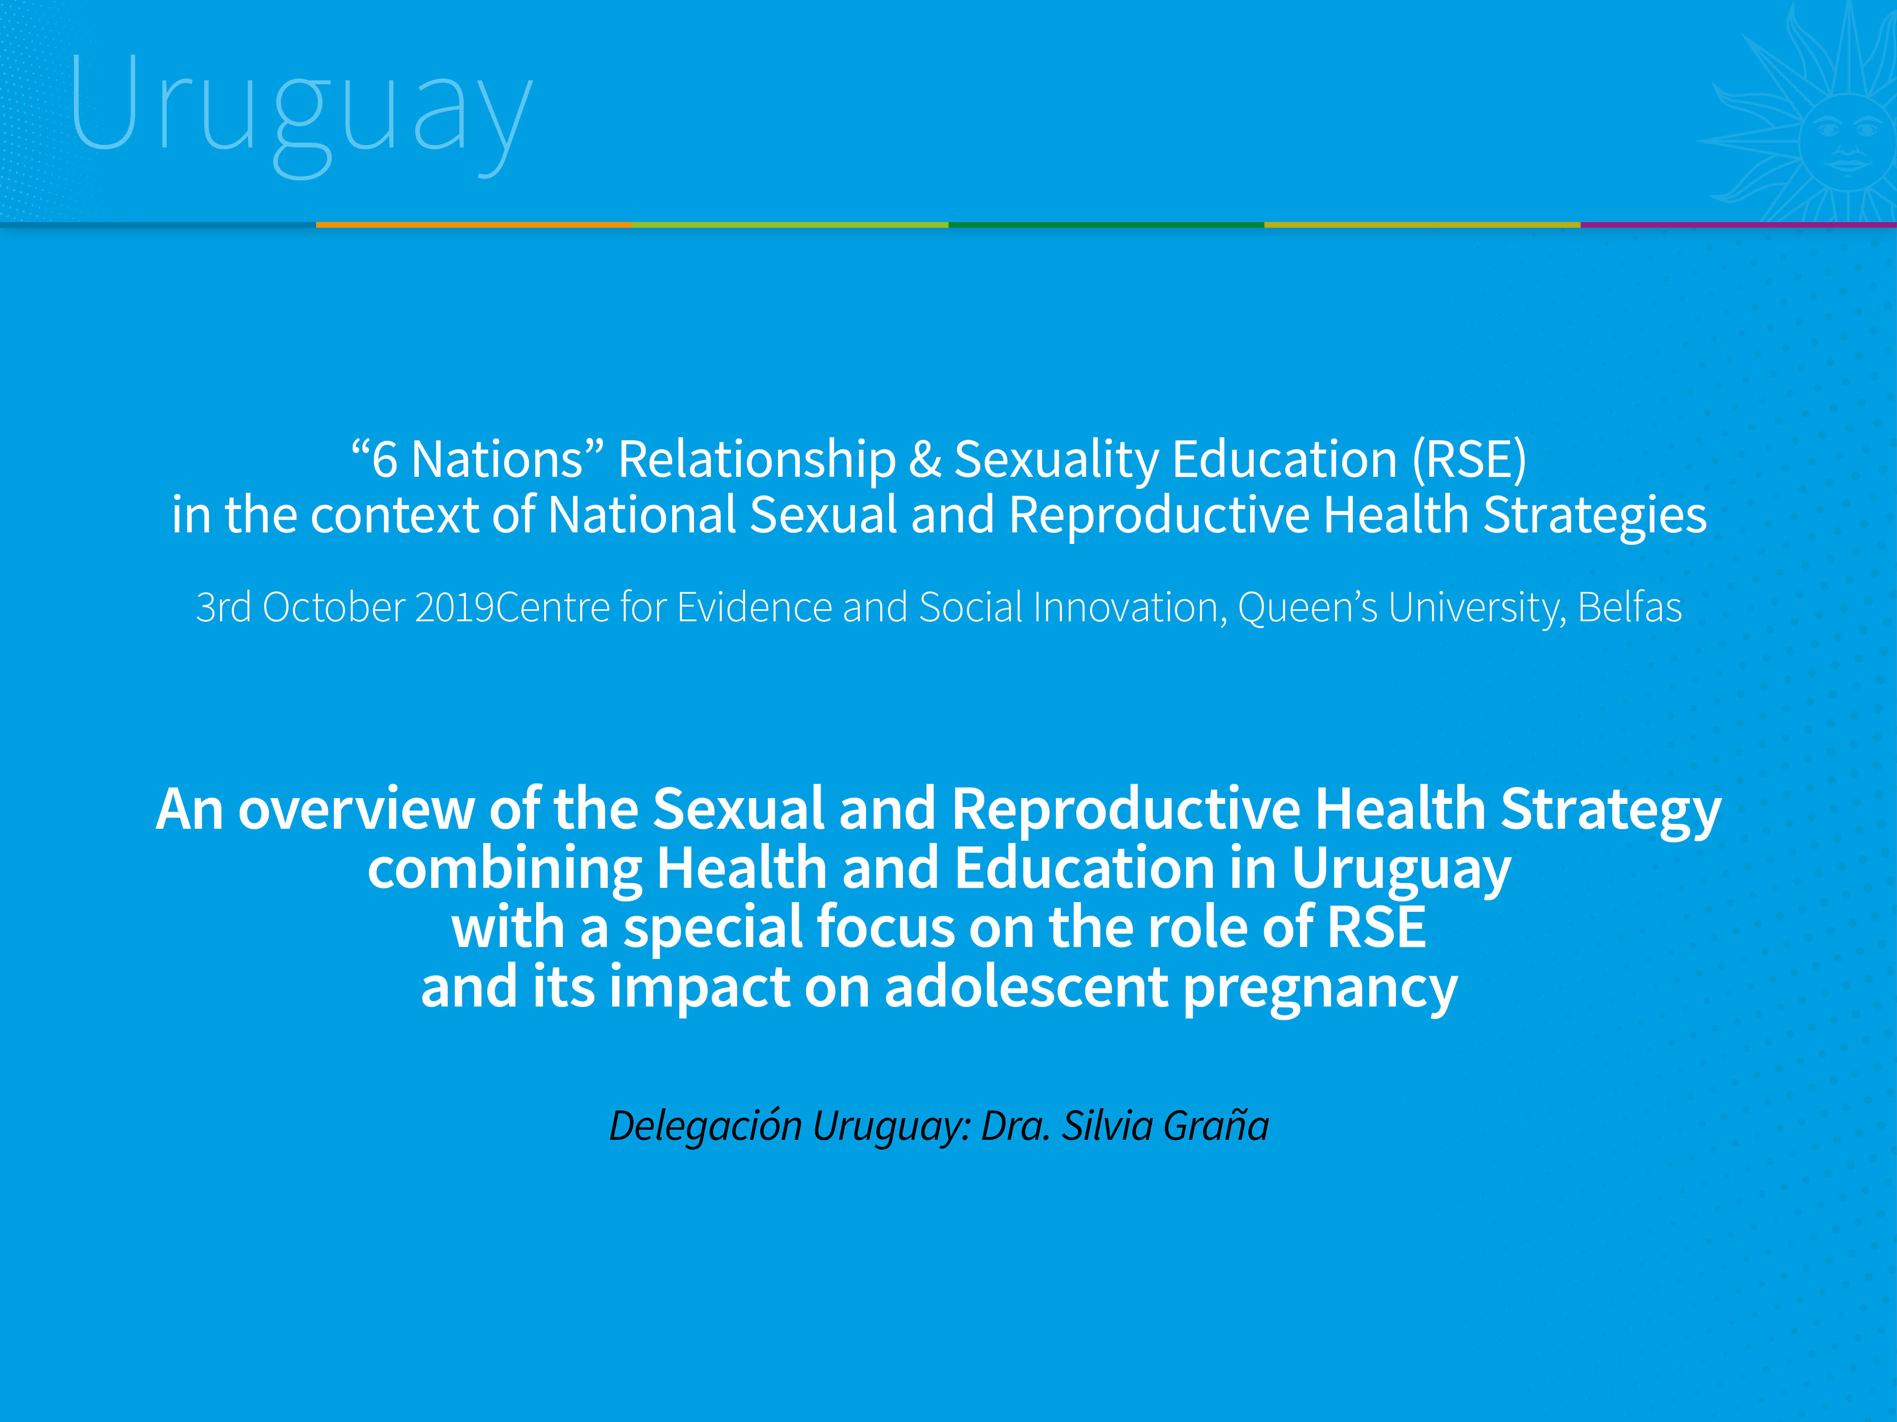

Slide 2

Contents
Country: Uruguay
Sexual and Reproductive Rights Policies (Sexual and Reproductive Health and Sexuality Education)
Public Policies - Timeline
Diagnosis
National Strategy
Outcomes
Challenges

Slide 3
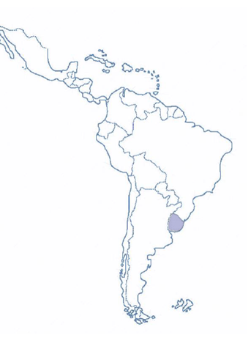
Secular State
Republican System with strong political parties
Free Public Education at all levels
National Integrated Health System
Population: 3.400.000 hab.
Surface: 176.215 km2
GDP. per cápita: U$ 17.500/ € 433
Poverty: 8,1%
GFR: 1,6
CM: 6,7/00

Slide 4
Since 2005, the government party is Frente Amplio (left parties and center left coalition): 2005-2010, 2010-2015, 2015-2020.
Continued economic growth since 2005, the longest period in national history. Substantial reduction of inequality (in 2005: Gini index reached 0.46 points and in 2017 it was 0.38).
Structural reforms of the State and development of public welfare policies: Tax Reform, Health Reform, Labor Market Reform and Social Policies Development.

Slide 5
Sexual and Reproductive rights:
Health and Education policies
Strong regulatory framework that recognizes sexual and reproductive rights as human rights.
National policies and programs on sexual and reproductive health and sexuality education.
Comprehensive services on sexual and reproductive health that includes access to legal abortion.
Sexuality Education Program is implemented throughout the education system from initial level to bachelor level, including training of teachers.
Cross-cutting approaches:
Intergenerational, Human Rights, Gender and Diversity

Slide 6
Key milestones: 2005-2018
2008
2010
2010
2012
2013
National law
of Education: Sexuality Education
National
Programme
of Sexuality
Education
Contraceptive methods (CM)
In National
Budget
Law of legal abortion until 12 weeks.
Abortion services in National Health System
National law of Sexual and Reproductive Rights
Health services on SRH at the National Health System
2014
2015
2016
2017
2018
Expansion in offer
Of contraception in Health services:
LARC (implants)
National
Health Objectives
National and intersectorial strategy of prevention of unintended adolescent pregnancy
Focus on girls and adolescent pregnancy (- 15 )

Slide 7

In spite of the achievements … in 2015 the evidences showed that:
High Adolescent fertility (55 / 1000)
Adolescent motherhood
71% would have preferred to postpone motherhood.
82% had no job nor were not looking for one
Social inequalities
70% dropped their studies before getting pregnant
57% were not studying or working : “Care responsibilities”
56% had first sexual intercourse at 15 years or less
Sources: ENAJ 2008, 2013, López y Varela, 2016)

Slide 8
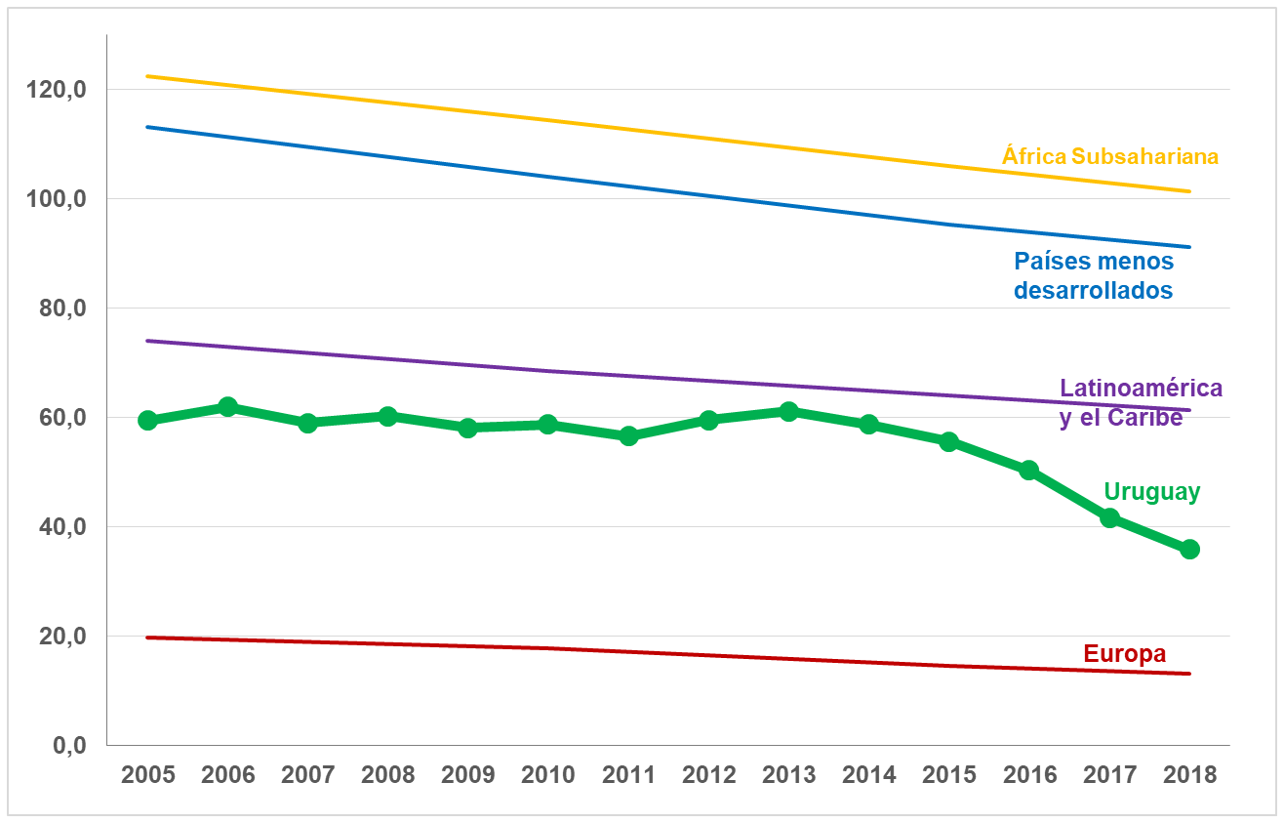
Recent evolution in adolescent fertility (according to Regions)
Resistent to low
Source: https://unstats.un.org/sdgs/indicators/database

Slide 9
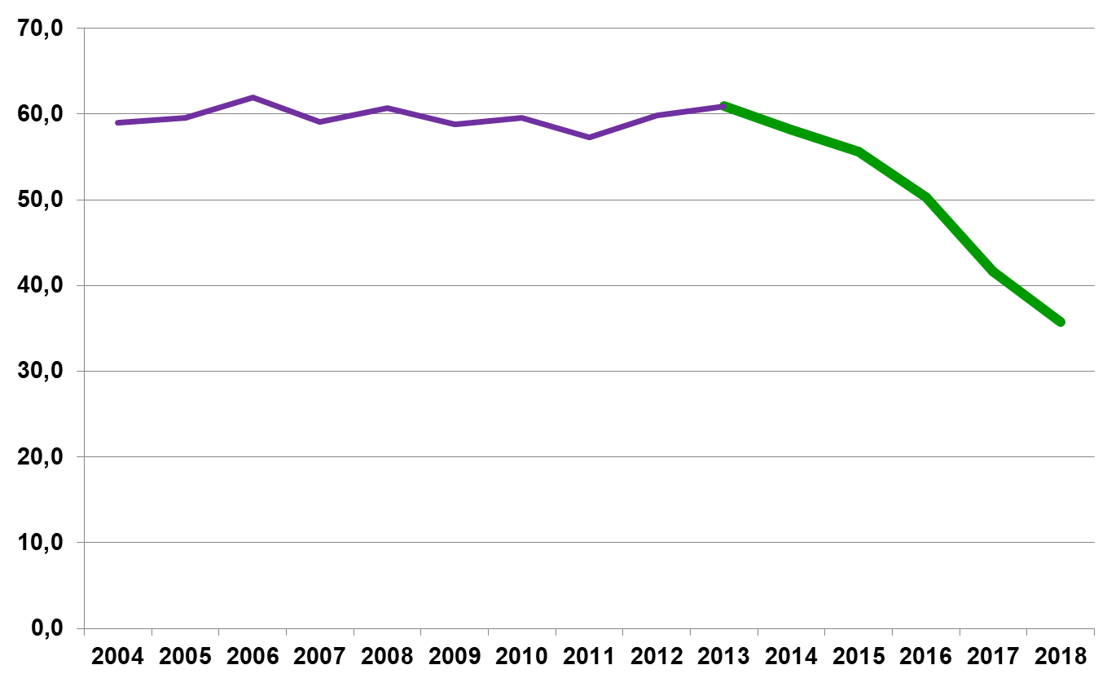
Evolution of adolescent fertility rates
(Uruguay 2004-2018*)
55 NV /1000 adolescents
36 NV /1000 adolescents
*Preliminary numbers

Slide 10
Legal abortion rates (until 12 weeks)

Slide 11
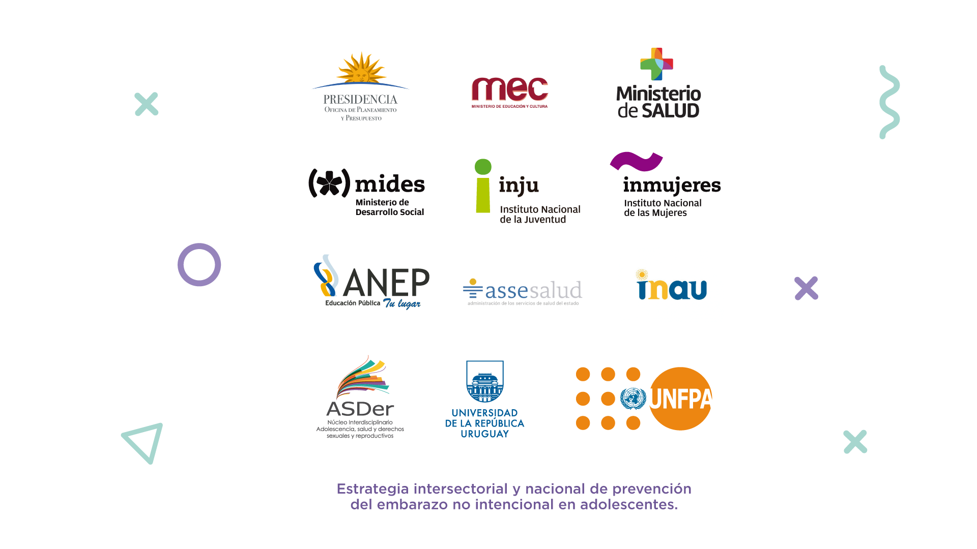

2015: National and Intersectoral Strategy for prevention of adolescent unintended pregnancy in Uruguay.
Presidency of the Republic.
Ministry of Education and Culture.
Ministry of Health.
Ministry of Social Development.
National Administration of Public Education.
University of the Republic.
National Institute for Childhood and Adolescence of Uruguay.
Technical and Financial support
UNFPA
UNICEF
BID
EUROSOCIAL

Slide 12
Purpose and objectives
Purpose: To contribute to social intergration, development and exercise of sexual and reproductive rights of girls, boys and adolescents from 10 to 19 years old in Uruguay.
Main Objective: To low the rate of unintended pregnancy in girls and adolescents and its determinants, guaranteeing the promotion and access to reproductive and sexual rights.

Slide 13
National Strategy
International commitments assumed by the country on promotion of sexual and reproductive rights.
High level national government agreement.
Intersectoral perspective and actions.
Based on research and scientific evidences.
Comprehensive approaches: human rights, gender, generations, race, diversity and adolescence as a specific stage.
Adolescent unintended pregnancy as an expression of social inequalities.

Slide 14
Structure of the Policy (National Strategy)
National Authorities
Local Coordination Technical Team
Coordinating Council
System Information Technical Team
Intersectorial Regional Groups
Communication Technical Team

Slide 15
Main actions
Transformation of gender norms and inequalities.
Adolescents health services (confidentiality, privacy, comprehensive services).
Knowledge and consistent use of contraceptive methods
Sexuality education for girls, boys and adolescents
Intersector teams in local levels
Communicational campaign.
Technical guidelines for prevention unintended adolescents pregnacy
Route map for preventing unintended pregnancy under 15 years old and to support the decision making process in case of pregnancy (to continue or to have an abortion).

Slide 16
Working Hypothesis: public policies may have influenced the decrease in adolescent fertility rate between 2015 and 2018.
Implementation of the National and Intersectorial Strategy for prevention of unintended pregnancy in adolescents (2016).
Incorporation of LARC (implant) in the provision of contraception at the National Health System (2014).
Implementation of legal abortion services in the National Heath System (since 2013).
Sex education in the curriculum of education sector (since 2008)

Slide 17
Challenges
From a government policy to a State Policy. Sustainability.
Adequate budget and financial support
To develop a comprehensive implementation of the National Strategy in regional and local levels.
To define a Monitoring & Evaluation model.
To increase the participation of civil society organizations, communities, families and children/ adolescents.
To promote enabling socio-educational environment for the development and exercise of human rights.
To generate new Scientifics evidences and innovative interventions to involve boys ant teens in the prevention of unintended pregnancy.
To increase the capacities and skills of teachers and health care professionals to promote sexual and reproductive rights, gender equality and prevention of unintended pregnancy in adolescents.

Slide 18

Many thanks!
saludado@msp.gub.uy

