Slide 1
If I Were Jack: Classroom Slides
ENGLAND
USE THIS FILE IF YOU ARE DELIVERING SIX LESSONS
(DELIVERY OPTION B)

Slide 2
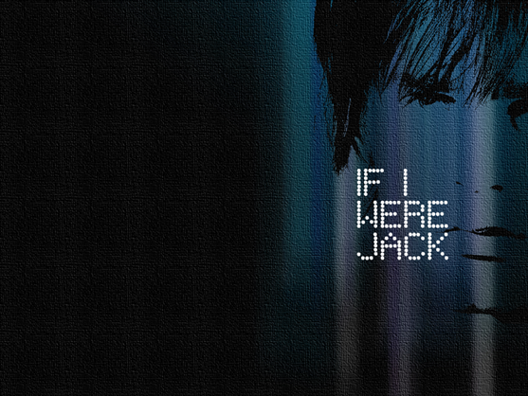
LESSON 1
Introduction to the If I were Jack Programme
If I Were Jack Interactive Video Drama
If I had to Look After a Baby

Slide 3
Introduction to the Programme
During the next four lessons we’ll be learning about unintended teenage pregnancy and staying safe when it comes to relationships, sex & pregnancy.
‘Unintended’ teenage pregnancy is when a teenager gets pregnant without expecting to or wanting to at that time. Sometimes called ‘unplanned pregnancy’.
What to do if you feel upset about anything.
Thinking this doesn't apply to you?

Slide 4
What is If I Were Jack?
In order to help us learn about teenage pregnancy we’ll be using the If I were Jack resource.
We start with a film about Jack and Emma.
Followed by 11 other activities over the next four lessons.
It’s a little different than other resources because:
It has been developed by researchers, sexual health experts and teenagers;
It’s the only resource about teenage pregnancy that considers the boy’s (and the girl’s) point of view;
It’s based on evidence about what helps young people stay safe and avoid unintended teenage pregnancy.

Slide 5
If I Were Jack Theory of Change Model…or ...how it works
Avoiding unintended pregnancy
Social influences
(e.g. understanding peers’ and parents’ beliefs and ideas about girls’ and boys’ responsibilities for avoiding pregnancy)
Skills
(e.g. ability to communicate about your sexual health, and use contraception)
Intentions
(e.g. having a plan to avoid unintended pregnancy and stay safe)
Knowledge
(e.g. Knowing how and where to find quality sexual health information and services)
Beliefs about outcomes
(e.g. understanding that unintended pregnancy could be a challenging experience)
Beliefs about abilities
(e.g. feeling able to communicate about what you want, and feeling able to use contraception)
Relationships, sex and pregnancy can all be really positive experiences when you are prepared and ready for them.
The purpose of this resource is to give you the knowledge, information and skills you need to help you avoid unintended pregnancy and stay safe.

Slide 6
If I Were Jack IVD
Link to the online version:
www.qub.ac.uk/if-i-were-jack/resources/ivdew
Username: [Teacher enter here]
Password: [Teacher enter here]

Slide 7
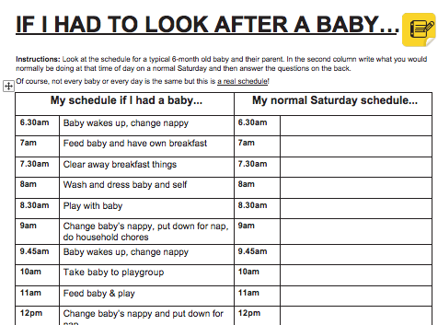
If I Had to Look After a Baby…
Instructions: Look at the handout of a schedule for a typical 6-month old baby and their parent. In the second column write what you would normally be doing at that time of day on a normal Saturday and then answer the questions on the back.
DISCUSSION
What did you think of the schedule?
Do you think having to look after a baby now would have an impact on your life?
Would you miss anything if you had a baby now?
What might be the positives of having a baby now?
What would be the hardest thing for you about having a baby now?
Would having a baby now impact on your future? How?

Slide 8
LESSON 2
Introduction to the lesson
Ground Rules
Previously on Jack: IVD Recap Video
Pause: Fast-forward: Rewind
What about Emma?

Slide 9
Ground Rules
R: Respect for everyone’s contribution by listening to one another’s views;
I: Involvement in the discussions and activities, when you feel comfortable doing so;
C: Confidentiality - that we are not going to talk about our own personal stories but we can talk about relationships in general;
E: Equality - we want to acknowledge that everyone’s experience and opinions are OK and there are no ‘right’ or ‘wrong’ opinions;
S: Stays – what is said in the room, stays in the room.

Slide 10
IVD Recap Video
Previously on Jack…
Find online version here:
www.qub.ac.uk/if-i-were-jack/resources/teachers

Slide 11
Pause: Fast-forward: Rewind
Instructions: It’s time to talk about Jack and Emma! In pairs or in small groups, discuss your thoughts on the questions below and then share your thoughts with the whole group.
FAST-FORWARD: Let’s talk about what might have happened next…
REWIND: Let’s talk about what might have happened…
PAUSE: Let’s talk about the film…

Slide 12
Pause: Fast-forward: Rewind
DISCUSSION
Who’s decision is it anyway?
How could Jack and Emma have avoided unintended pregnancy?
Can you think of any positives about becoming a teenage parent?

Slide 13
What about Emma?
Instructions: Think about the possible positive and negative outcomes for Emma of keeping the baby, having the baby adopted or having an abortion.
Alternative 1: Keeping the baby
POSITIVES | NEGATIVES
Alternative 2: Having the baby adopted
POSITIVES | NEGATIVES
Alternative 3: Having an abortion
POSITIVES | NEGATIVES

Slide 14
LESSON 3
Introduction to the lesson
Fact or Fiction?
Jack Forum Dilemmas
Wallet Card Homework

Slide 15
Fact or Fiction?
Most teenagers do not have sex before they are 16.
You can get pregnant the first time you have sex.
Teenagers who have a child together usually end up getting married to each other.
The only way to avoid pregnancy is to not have sex.
Contraception is really expensive.
When young people have sex, most of them use condoms.
It’s illegal to have sex before the age of 16.

Slide 16
Fact or Fiction?
Most teenagers do not have sex before they are 16. FACT
You can get pregnant the first time you have sex. FACT
Teenagers who have a child together usually end up getting married to each other. FICTION
The only way to avoid pregnancy is to not have sex. FICTION
Contraception is really expensive. FICTION
When young people have sex, most of them use condoms. FACT
It’s illegal to have sex before the age of 16. FACT

Slide 17
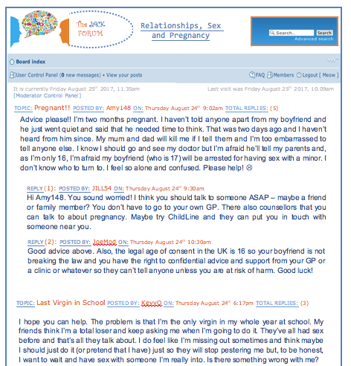
Jack Forum Dilemmas
Instructions: Read the dilemmas and responses posted on the Jack Forum and discuss them as a whole group.
DISCUSSION
What did you think of the dilemmas and the advice given?
Would you offer any different or additional advice to anyone?
Remember the JACK online forum is not a real forum!
You can discuss issues such as these online on the ChildLine website.

Slide 18
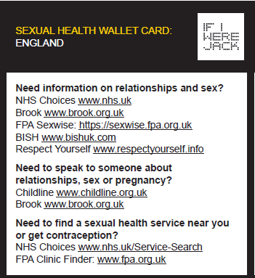
Homework…Wallet Card
Have a look at the websites listed.
See if you can find anything interesting.
See if you can find out something you didn't know before.
Keep the wallet card safe for future use!

Slide 19
LESSON 4
Introduction to the lesson
Homework Review: Jack Wallet Card
Online Scavenger Hunt

Slide 20
Homework Review: Wallet Card
Did you look at the websites?
What did you think of them?
Did you find anything interesting?
Did you find anything you didn't know?
Keep the wallet card safe for future use!

Slide 21
Online Scavenger Hunt
List 11 things you should think about before you decide to have sex.
List four places where you can get free contraception.
Find out one thing you didn’t know about sex and the law.
List seven methods of contraception. Which method prevents both sexually transmitted infections and pregnancy?
What number could you call for confidential information and advice about relationships, sex and pregnancy? What other ways can you contact ChildLine?

Slide 22
LESSON 5
Introduction to the lesson
Staying Safe Scenarios
JACK Survey Homework

Slide 23
Staying Safe Scenarios
You go to a party and have way too much to drink. The next thing you know you are in a bedroom with someone who is expecting to have sex with you. This is not what you want. What would you say?
Someone wants to have sex with you but neither of you have a condom. The other person thinks you should risk it. You don’t think it’s a good idea but they keep trying to persuade you. What would you say?
Your boyfriend/ girlfriend wants to have sex with you, but you don’t feel ready. What would you say?
You really want to have sex with your girlfriend/boyfriend but she/he doesn’t want to. What would you say?
You have sex with someone and afterwards you realise that the condom has split. What would you do?
You want to have sex with a girl and you don’t have a condom. She says ‘it’s OK’ and you assume she’s on the pill. Later you regret having unprotected sex. What would you do?
You are with someone who is drunk. She/he says she/he wants to have sex with you now. What would you say?

Slide 24
Staying Safe Scenarios
PLEASE REMEMBER…
If you are having sex, always use a condom. It will protect you from unplanned pregnancy and sexually transmitted infections (STIs).
If you have unprotected sex, girls should get emergency contraception as soon as possible and both boys and girls should get get checked for sexually transmitted infections.
The ‘age of consent’ is 16 but this does not mean that you should have sex at that age. This law exists to protect those under 16 from sexual abuse. It’s totally OK to wait until you are ready.
Never assume the person you are having sex with is sorted for contraception. If you want to avoid pregnancy and STIs, you need to know what contraception you will use.
If you think you might have sex, you should always carry condoms with you.
No always means no. If you want to have sex, you must always make sure that you’re both happy and comfortable doing so, and that the other person has consented.
Having sex with someone who is drunk or has taken drugs is wrong because they may be not be able to consent to having sex – that is fully say yes to having sex. When someone doesn’t consent, that’s sexual assault.
Boys and girls have equal responsibility to avoid unintended pregnancy and STIs.

Slide 25
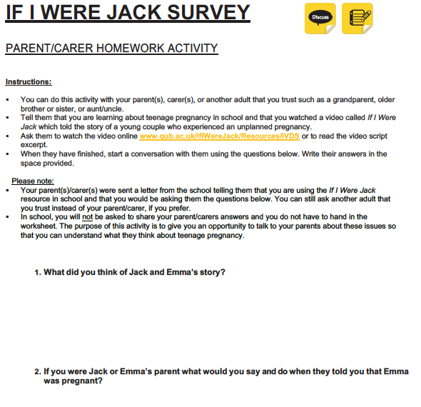
Homework…JACK Survey
Instructions:
Ask your parent/carer (or another trusted adult such as an older brother/sister, aunt/uncle or grandparent) to watch the Jack film or read the script.
Afterwards ask them to answer the 3 questions.
You don’t have to hand in the survey and you will keep their answers confidential.
We’ve sent your parents/carers a letter telling them about this activity.

Slide 26
LESSON 6
Introduction to the lesson
Homework Review: JACK Survey
Controversial Statements
My Plan

Slide 27
Homework Review…JACK Survey
Discussion
Did you do the activity?
Who did you survey?
How was it speaking to this person about these issues?
Were you surprised by their responses to the questions?

Slide 28
Controversial Statements
Some women wear clothes that ask for sex
Men are better at making decisions than women
A woman’s place is in the home
Teenagers from poor families are more likely to have an unplanned baby than teenagers from rich families
Men should go out to work and women should stay at home and look after the children
Religious women would never have an abortion
Abortion is always wrong
If you haven’t had sex by the time you’re 18, there must be something wrong with you
Women who carry condoms are sluts
Only people with money have abortions
The only thing men think about is sex
Marriage is an end to freedom
Pregnancy is a women’s issue
You should be married before you have children
Men pretend they’ve had more sex than they really have and women pretend they’ve had less sex than they really ha
Contraception is a woman’s responsibility

Slide 29
My Plan
Instructions: Think about how you would feel if you were in a heterosexual relationship and you or your partner got pregnant now. Think about the questions on the handout and write your answers in the spaces provided.
Your answers are confidential and will not be collected by the teacher.
DISCUSSION
How confident are you in your plan?
Are there other things you need to know or find out?

Slide 30
If I Were Jack Programme Wrap-Up
DISCUSSION
Did you enjoy using the If I Were Jack resource?
What messages will you take away with you?

