Slide 1
The JACK Pilot Study:
Teacher Training Session
INSERT TEACHER TRAINER NAME INSERT DATE OF DELIVERY
Notes:
Before we get started, let’s just take a moment to introduce ourselves, including any information about your role in relation to RSE within your school.

Slide 2
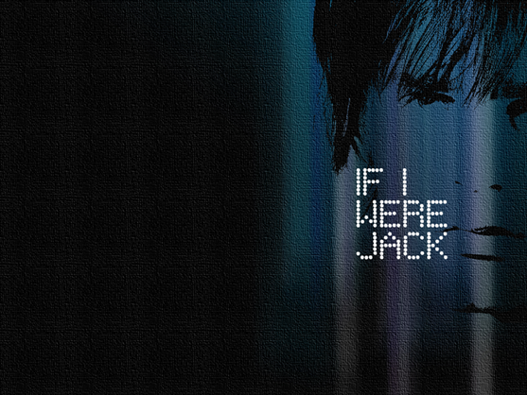
The If I Were Jack resource
An educational resource based around an interactive film that aims to prevent unintended teenage pregnancy and promote positive sexual health.
Developed by researchers at Queen’s University Belfast, in consultation with researchers at other UK universities, as well as health and education experts, teacher trainers, teachers, young people and parents from across the UK.
Currently being piloted before progression to a larger trial to see if it has any effect on young people’s knowledge, attitudes and behaviour.
Notes:
The aim of today’s session is to introduce you to an educational resource called If I Were Jack.
If I Were Jack is based around an interactive film aiming to prevent unintended teenage pregnancy and promote positive sexual health.
The resource has been developed by researchers at Queen’s University Belfast in consultation with researchers at other UK universities, and also in consultation with health and education experts, teacher trainers, teachers, young people and parents from across the UK.
As it was originally developed in Ireland and NI, we’ve adapted the resource for use in England, Scotland and Wales, and are now piloting it in one school in each nation before deciding whether to progress to a larger trial to see if it has any effect on young people’s knowledge, attitudes and sexual behaviour.

Slide 3
How is your school involved?
[insert name of school] is one of three schools participating in the pilot study of the If I Were Jack resource
The main aims of the pilot are to determine:
Do pupils understand the interactive film?
Would teachers choose to use the interactive film again?
What are parents’/guardians’ views about the film?
How well do the researchers’ processes for collecting data from pupils, teachers and parents work?
Your role is to deliver If I Were Jack to your Year INSERT pupils in the way the researchers intend.
Notes:
[insert name of school] is one of three schools (one in each of England, Scotland and Wales) participating in the pilot study to be conducted before the main JACK Trial.
The main aims of this pilot study are to determine if pupils can understand the interactive film, if teachers would choose to use the interactive film again, how parents’/guardians’ feel about the resource, and also for us as researchers to test our processes for collecting data from pupils, teachers and parents.
As teacher participants in this research study, you have the important and valued role of being responsible for delivering If I Were Jack to your Year INSERT pupils in the way the researchers intend, and so that’s what we’ll go through today.

Slide 4
Objectives of this session
I’m here today to provide:
An overview of the If I Were Jack resource, its key messages and educational objectives;
A brief demonstration of the film;
An overview of the classroom activities and materials;
Guidance on how the resource should be delivered;
Clarification and answer questions.
Notes:
In terms of today’s session, I’m here today to:
Provide an overview of the If I Were Jack resource, its educational objectives and overarching ethos;
Then I’ll give you a brief demonstration of the film and we’ll look at the classroom materials that have been developed for use alongside the film.
Then we’ll talk about how the resource should be delivered
And finally we’ll have time at the end of the session for questions.
That said, please do ask if you would like anything clarified as we go along.
Does that sound OK with everyone?

Slide 5
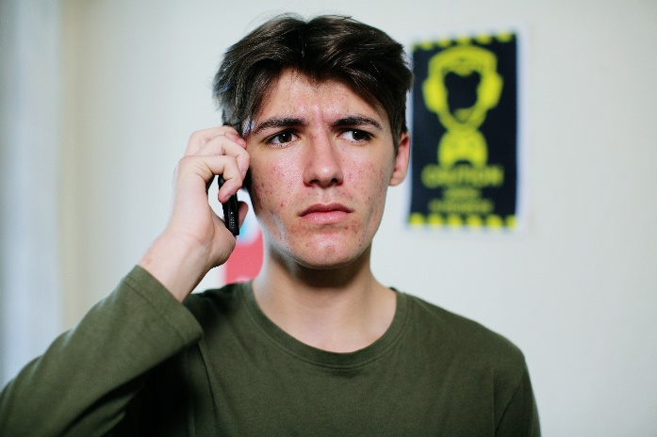
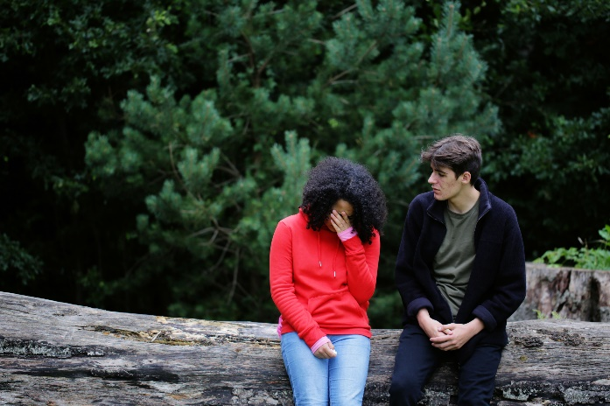
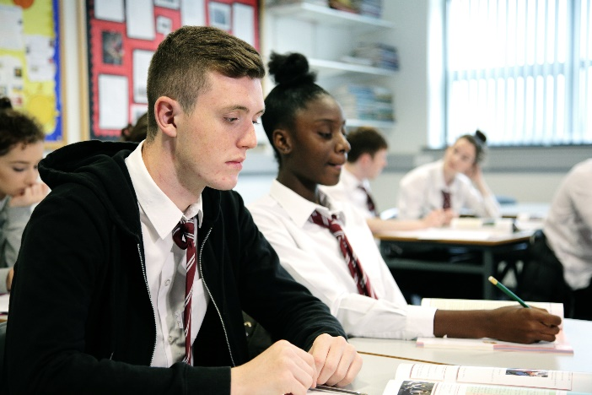
What is the If I Were Jack resource?
The interactive film tells the story of Jack, a teenager who has just found out that his girlfriend Emma is unexpectedly pregnant.
Addresses the longstanding neglect of teenage men in relation to pregnancy education, yet also encourages reflection and discussion among teenage women.
Suitable for use in same-sex and mixed-sex classrooms.
Based on best available theory and evidence about what works in attempting to decrease unintended pregnancy among teenagers.
Notes:
Based around an interactive film which tells the story of Jack, a teenager who has just found out that his girlfriend Emma is unexpectedly pregnant.
As the young person views the film they are encouraged to put themselves in Jack’s shoes and consider how they would feel if they were in his situation.
You can see some stills from the film here.
While the resource focuses on unintended pregnancy from the perspective of teenage men, it is suitable for use in same-sex and mixed-sex classrooms.
The reason for the focus on teenage men is that they have been neglected in relation to pregnancy education, even though they play an obvious role in the prevention of teenage pregnancy, and research shows that they influence teenage women’s intention to avoid unintended pregnancy.
The interactive film and accompanying materials are based on theory about how to best change sexual behaviours and the best available evidence about what works in attempting to decrease unintended pregnancy among teenagers.

Slide 6
If I Were Jack: Key messages
Relationships, sex and pregnancy can be positive experiences when they are mutually consensual and an individual is prepared and ready for them;
Young men, as well as young women, have roles and responsibilities with respect to relationships, sex and pregnancy;
With the correct skills and knowledge, young men and women can make safe and responsible decisions in relation to relationships, sex and pregnancy;
Unintended pregnancy can be a stressful experience for some people that may involve difficult decisions and potentially challenging outcomes;
It is important for young people to consider their personal values and beliefs regarding relationships, sex and pregnancy and to make a plan for positive experiences that are in line with these;
Confidential and impartial support and information is available locally and online for young people in relation to all aspects of their sexual health.
Notes:
If I Were Jack takes a positive, comprehensive, objective and non-judgemental approach to RSE.
The resource has the following key messages (see slide).

Slide 7
If I Were Jack: Ethos
Encourages discussion of various options that may be open to a young person if they experience an unintended pregnancy (i.e. keeping the baby, adoption and abortion) with no suggestion that any of these options is preferable.
Directs viewers to consider all of the options and their potential outcomes, thereby encouraging reflection on how their decision might be affected by their own individual values.
Designed to fit within a broad range of school contexts, and has been developed in a range of schools, including faith-based schools.
Notes:
Essentially the film encourages discussion of various options that may be open to a young person if they experience an unintended pregnancy (i.e. keeping the baby, adoption and abortion) with no suggestion that any of these options is optimal.
Rather, the resource directs viewers to consider all of the options and their potential outcomes, thereby encouraging reflection on how their decision might be affected by their own individual values.
The resource provides an opportunity for the teacher to identify the school’s position on these issues, should they wish.
It also facilitates young people to discuss the issues with their parents/guardians.
The intention here is that the resource can be used in as many post-primary schools as possible, and it has already been successfully tested in a range of schools, including faith-based schools.

Slide 8
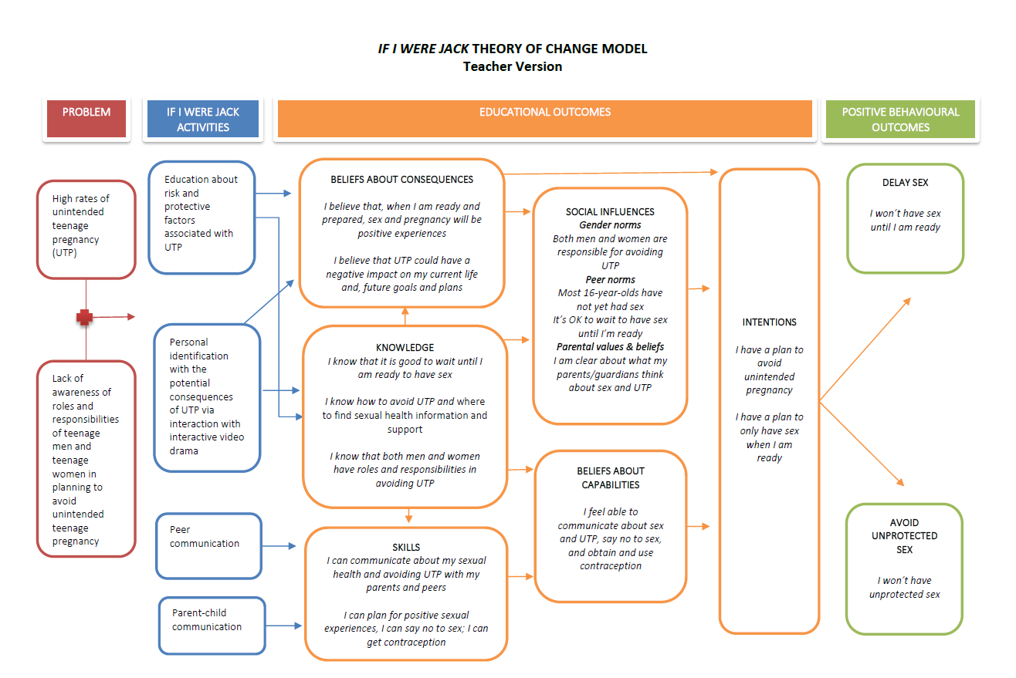
Notes:
As noted before, as students watch the film, they are encouraged to put themselves in Jack’s shoes and think through how they would feel in this situation. In this way, the resource encourages reflection and anticipatory thinking about unintended pregnancy and its potential consequences with the ultimate aim of increasing young people’s intention to avoid teenage pregnancy.
On this slide, you can see the If I Were Jack Theory of Change Model, which essentially presents the underlying logic of how the resource aims to increase young people’s intention to avoid pregnancy.
You can see from this that the resource has been designed to target the six educational outcomes (or psychosocial factors) presented in orange in the centre of the diagram.
Research has shown that these six factors can impact on young people’s intention to avoid pregnancy by encouraging them to either delay having sex until they are older or, if they are having sex, to always use contraception.
The film and all the activities that are part of the If I Were Jack resource have been included because they can impact on one or more of these factors.
So for example, the film gives young people the message that unintended pregnancy can be stressful and may have challenging consequences for their lives.

Slide 9
How should the resource be used?
The resource is designed to fit within the RSE curriculum and should be delivered at Key Stage 4.
Depending on the length of lessons in your school, you can choose from the following options:
Four 50-60 minute lessons;
Six 35-45 minute lessons.
It can be delivered as one or two lessons a week over a number of consecutive weeks or during one day-long session.
Notes:
If I Were Jack is designed to fit within the RSE Curriculum and should be delivered at Level 3/4.
The resource can be delivered in a way that suits your school’s normal procedure for RSE. Depending on the length of lessons in your school, you can choose from the following options:
Four 50-60 minute lessons; or
Six 35-45 minute lessons.
It can be delivered as one or two lessons a week over a number of consecutive weeks or during one day-long session.
As this is a pilot study, in order to increase our understanding of how well the resource works in practice, we would like you to deliver all of the components as per the instructions provided in the classroom materials.
We’re going to watch a bit of the film, and then go through the classroom activities in a moment, but I just wanted to check at this stage, does anyone have any questions so far?

Slide 10
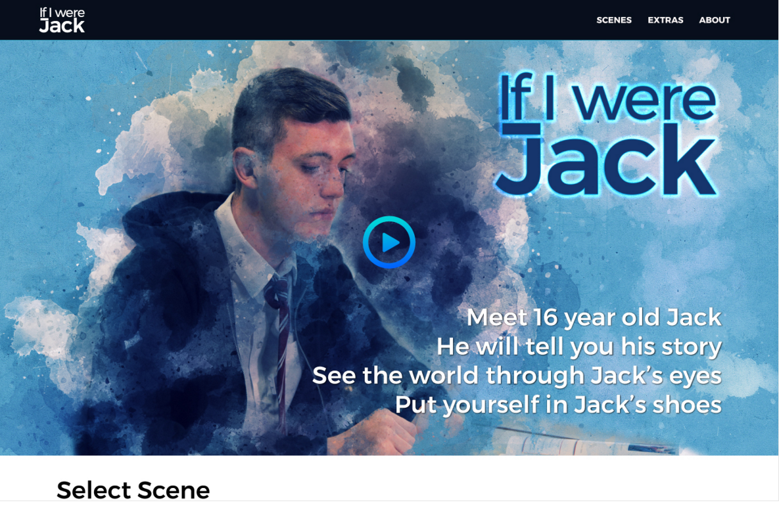
https://vimeo.com/237597593
https://vimeo.com/237597060
Notes:
We will now watch some of the film.
During the first lesson students watch the film (ideally at a computer on their own).
As the film proceeds questions appear on the screen which the young person must answer before continuing.
Open the programme and allow the film to play until the first question appears.
Explain that the film continues like this for around 20 minutes.
Continue for a further 5 minutes.
Demonstrate the menu feature and then skip to the last sequence]

Slide 11
Delivering the If I Were Jack resource: Dos & don’ts
Please do! | Please don’t!
Book a computer room/tablets for the first session when students watch the film. | Allow students to view the IVD in pairs or small groups.
Ensure that students have enough space in the computer lab or classroom so that they can answer the questions confidentially. | Collect any paper from students if they watch the film on a monitor/screen.
Watch the IVD in full before using it in the classroom.
Notes:
During the first lesson students watch the IVD, ideally at a computer on their own.
In a prior pilot research study students said that they engaged with this method more and that they were less influenced by other students in the classroom.
We will supply ear/headphones for this, but you will need to book a computer room/tablets for the first session.
It can be shown on a monitor/screen if you feel that would be more appropriate. For example, it might be easier to show on an overhead projector if there are a lot of students in the class with reading difficulties (that way you can explain words if needed).
If students watch the film on a monitor/screen they can fill in a paper version of the questions that accompany the film as they go along. This is for the students benefit only and you should not collect them.
You should not allow students to view the IVD in pairs or small groups. It either needs to be watched on individual computers/tablets or as one group on an monitor/screen.
Please ensure that students have enough space in the computer lab or the classroom so that they can answer the questions confidentially. If you think your classroom is too small to allow this, please arrange for this lesson to take place in a larger room if at all possible.
We recommend that you watch the IVD in full before using it in the classroom.
Does anyone have any questions about the IVD?

Slide 12
Notes:
Once students have watched the film, there are a series of classroom based activities which encourage them to think about and plan how to avoid teenage pregnancy.
[hand out copies of the Classroom Materials document]
The document contains detailed lesson plans as well as the resources that you will give to students in the appendices.
There are 14 activities in total. I will now briefly go through each of these in turn.
[Go through each activity briefly explaining what they are about and what the teacher should do]
Note that one of the lessons includes a homework exercise in which students are asked to encourage a parent/carer to watch the film and then answer a number of questions on issues raised in the film. The aim is to provide parents/carers and teenagers with an opportunity to communicate about sex, relationships and pregnancy. An information letter template for sending to parents is also provided. This will be posted out by your school in advance. Teachers should remind students that their parents/carers are aware they’re taking part in this programme and will be expecting them to bring home the homework exercise. If students prefer, they can do the exercise with another trusted adult other than their parents/carers.

Slide 13
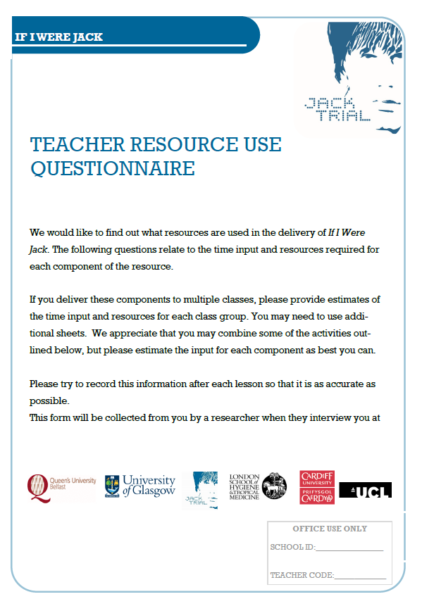
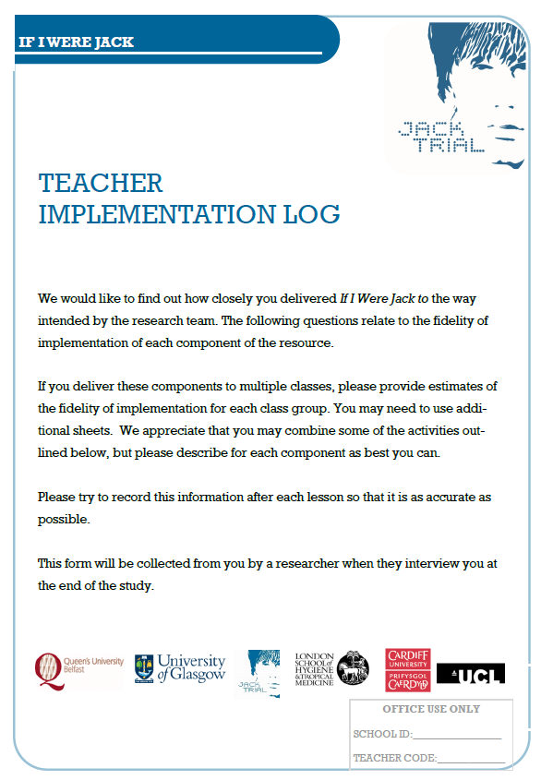
Can I just make a few tweaks here and there…?
For the purposes of The JACK Pilot Study, the research team need to ensure that the resource is delivered as planned so that they can test if there are any issues with how students, teachers or parents/carers engage with it.
If you make any changes, however minor, please record the change in the teacher implementation log form and the teacher resource use form and inform a member of the research team.
Notes:
[check with Aine if we’re using these two forms in the pilot]

Slide 14
Some advice from students!
Don’t take it too seriously. It’s better if the teacher has a sense of humour as this helps us not feel embarrassed or awkward.
Don’t act embarrassed or awkward. Instead be open, honest and light-hearted about it. That will help us relax and open up.
Be respectful of different points of view and don’t judge us if we say something you don’t agree with.
Adopt a ‘what’s said in the room, stays in the room’ policy and don’t mention anything we say to us or anyone else outside the lesson.
When we are answering the questions in the film or filling in worksheets give us the space we need to do so privately. We probably won’t be honest if we think the teacher is looking over our shoulders.
Notes:
We’d also like to share with you some of the findings from our earlier research during which we asked students about how they would like their teachers to deliver the resource.
Here are some of the things they said [see slide].

Slide 15
Accessing the If I Were Jack resources
I will give you hard copies of the If I Were Jack film, Information for Teachers booklet, and Classroom Materials booklet today.
The film and resource materials can also be downloaded from our website: www.qub.ac.uk/IfIWereJack/Resources
If you encounter difficulties on the day with accessing the film online, you have the back-up hard copy that could be used to deliver to the group on a large monitor/screen.
Please remember to test the film beforehand – both online (i.e. in the way students will try and gain access) and using the back-up hard copy.
We recommend that you liaise with your school computer officer/IT technician to ensure that the Jack website (and other websites listed in the classroom materials) are not blocked from the school network.
The film can be placed on the school network for viewing if preferable.
It is very important to the research team that none of the If I Were Jack resource materials or access passwords are shared outside of the school at this time.

Slide 16
Any questions?
If you need to ask any more questions or seek clarification after you have had further time to consider you can contact:
INSERT YOUR NAME AND CONTACT INFO

