Slide 1

The JACK Trial
Training session for teachers: (Add Location i.e. NI)
Trainer: Add Trainer Name

Slide 2
Consent to record session
We would like to audio-record this training to ensure that you received the course as it was designed to be delivered.
I will advise you when the recording starts and stops. The research team will listen to the recording to check if all the components of the course were covered. Only the research team will listen back to the recording.
Anything you say on the recording will be kept entirely confidential by the researcher and your name will not be linked to the recording.
It is up to you whether or not you want to participate in this research.
Notes:
Before we start, I’d just like to check with you whether you are happy for this session to be audio-recorded.
As previously outlined when your school signed up to take part in the JACK Trial, we would like to audio-record this training to ensure that you received it as it was designed to be delivered.
Following the training, the research team will listen to the recording to check if all the components of the course were covered. Only the research team will listen back to the recording.
Anything you say on the recording will be kept entirely confidential by the researcher and your name will not be linked to the recording. The recording of the training and this consent form will be stored separately in our offices on a computer that only members of the research team can access. We will write reports that include data on how accurately the training was delivered.
It is up to you whether or not you want to participate in this research. If you are happy for the training to be audio recorded, please complete the consent form and return it to the me (Teacher Trainer). If you are not happy for the training to be audio recorded, please speak directly to me.
I will advise you when the recording starts and stops.

Slide 3
Introductions
You can personalise this slide with information about your self

Slide 4
Aims of the session
I’m here to:
Provide an overview of If I Were Jack, its educational objectives and key messages
Provide a brief demonstration of the interactive film
Provide an overview of the classroom activities and materials
Provide guidance on the protocol for delivering the resource
Answer questions and provide clarification.

Slide 5
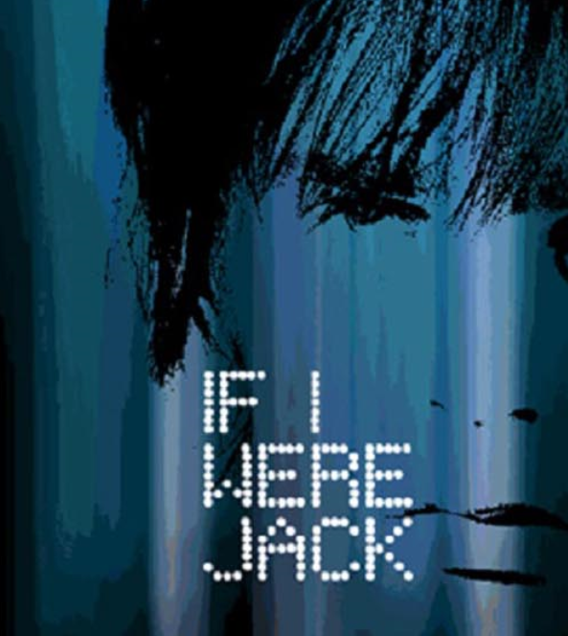
The JACK Trial
If I Were Jack is a new educational resource based around an interactive film that aims to prevent unintended teenage pregnancy and promote positive sexual health and relationships.
Developed by researchers at Queen’s University Belfast, in consultation with researchers at other UK universities, health and education experts, teachers, young people and parents from across the UK.
Has been piloted in schools in Scotland, England & Wales.
Now conducting a large UK-wide trial (The JACK Trial) to see if the resource has any effect on young people’s knowledge, attitudes, intentions and behaviour.

Slide 6
Allocation to intervention group
Your school has been assigned to the intervention group (meaning you will receive the JACK resource)
You have the important and valued role of delivering If I Were Jack to your Year 10/ 11 / S3 pupils in the way the researchers intended.
Notes:
Your school has agreed to take park in the JACK Trial and has been assigned to the intervention group and as teacher participants in this research study, you have the important and valued role of being responsible for delivering If I Were Jack to your Year 10/ 11 / S3 pupils in the way the researchers intended.

Slide 7
Session overview
Overview of If I Were Jack resource
Demonstration of the interactive film
Overview of the classroom activities and materials
Delivering the resource
Accessing the resource
Recording your use of the resource
Questions & wrap-up
Training Satisfaction Questionnaire/ Teacher Consent

Slide 8
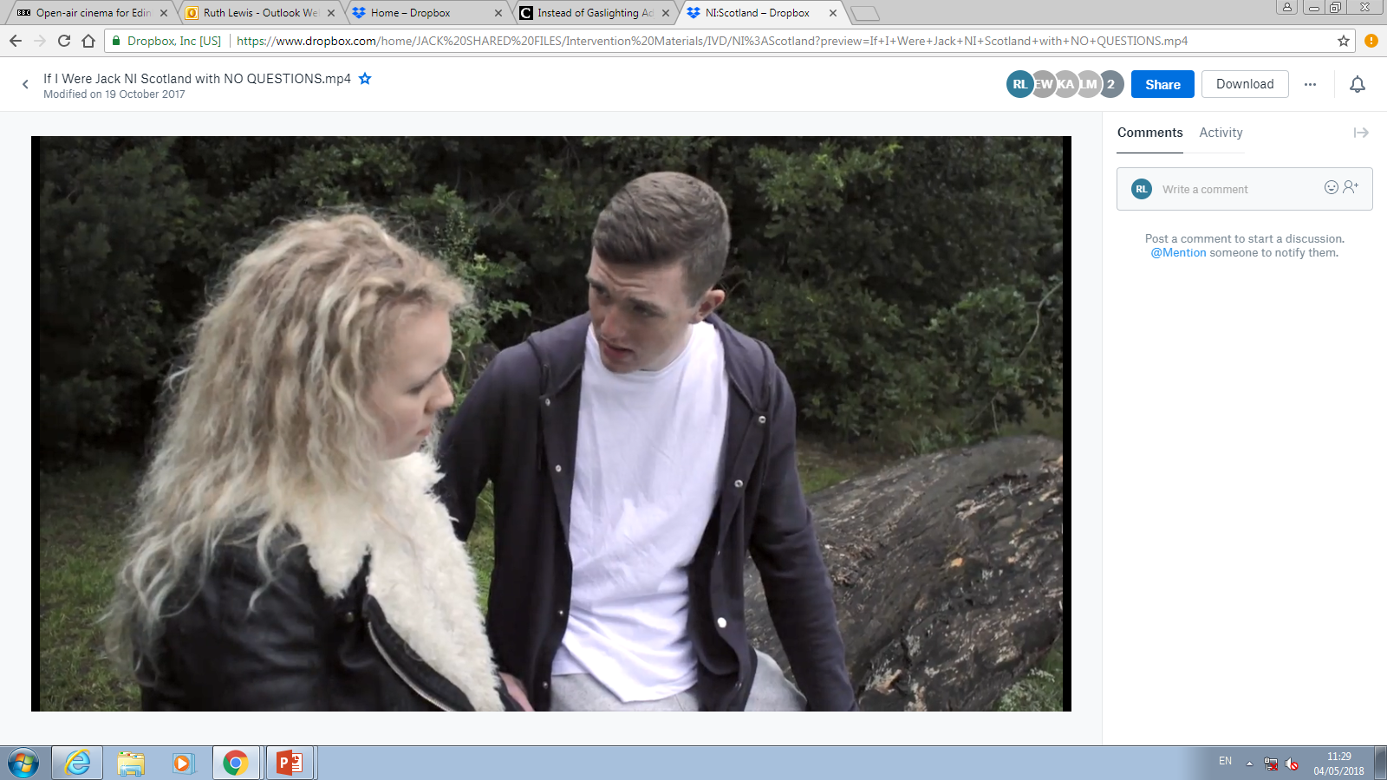

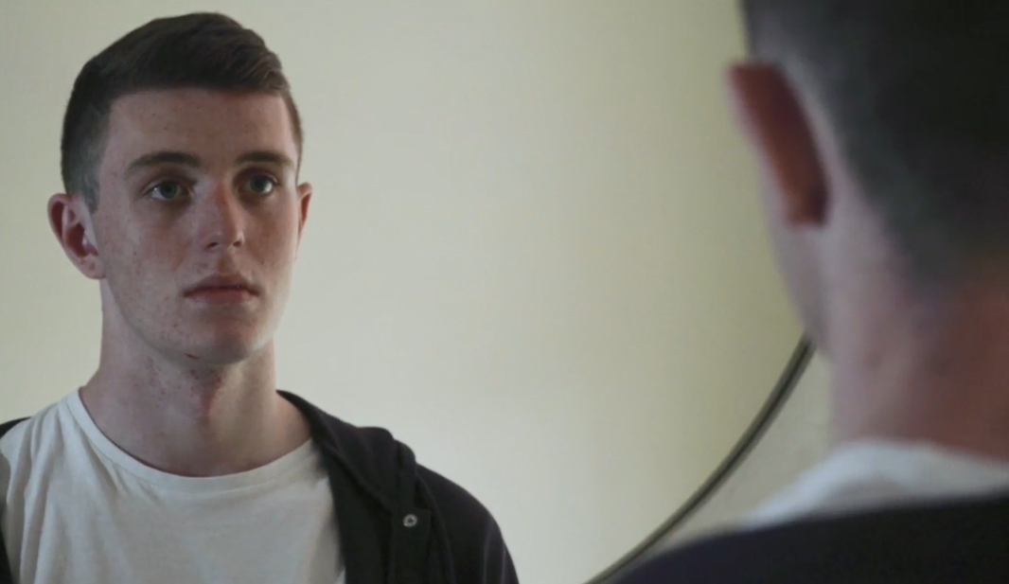
The If I Were Jack resource
Based around an interactive film that tells the story of Jack, a teenager who has just found out that his girlfriend Emma is unexpectedly pregnant.
Addresses the longstanding neglect of teenage men in relation to pregnancy education, yet also encourages reflection and discussion among teenage women.
Suitable for use in same-sex and mixed-sex classrooms.
Based on theory and evidence about what works in attempting to decrease unintended pregnancy among teenagers.
Notes:
Based around an interactive film which tells the story of Jack; a teenager (16 years old) who has just found out that his girlfriend Emma is unexpectedly pregnant.
Focuses on unintended pregnancy from the much-neglected role and perspective of teenage men in relation to teenage pregnancy, but is designed to encourage reflection and discussion among teenage women, as well as teenage men, and to go beyond the gender stereotypes surrounding teenage pregnancy.
It is therefore suitable for use in same-sex and mixed-sex classrooms.
Teenage men have been neglected in relation to pregnancy education, even though they play an obvious role in the prevention of teenage pregnancy and research shows that they influence teenage women’s intention to avoid unintended pregnancy.
The film and accompanying materials are based on theory about how best to change sexual behaviours and the best available evidence about what works in attempting to decrease unintended pregnancy among teenagers.

Slide 9
Key messages of the resource
Relationships, sex and pregnancy can be positive experiences when they are mutually consensual and an individual is prepared and ready for them;
Young men, as well as young women, have roles and responsibilities with respect to relationships, sex and pregnancy;
With the correct skills and knowledge, young men and women can make safe and responsible decisions in relation to relationships, sex and pregnancy;
Unintended pregnancy can be a stressful experience for some people that may involve difficult decisions and potentially challenging outcomes;
It is important for young people to consider their personal values and beliefs regarding relationships, sex and pregnancy and to make a plan for positive experiences that are in line with these;
Confidential and impartial support and information is available locally and online for young people in relation to all aspects of their sexual health.
Notes:
These are the key messages of the resource [read through]

Slide 10
Educational aims/ objectives
To increase teenagers’ awareness of:
how relationships, sex and pregnancy can be positive experiences when they are mutually consensual and a person is prepared and ready for them;
their own personal attitudes, values and beliefs with regard to relationships, sex and pregnancy and how to effectively communicate these to others;
the attitudes, values and beliefs of their family and peers in relation to relationships, sex and pregnancy;
the importance of personal responsibility and agency in avoiding unintended pregnancy;
gender norms and stereotypes associated with relationships, sex and pregnancy
reliable sources of online information on sexual health; and
information on local sexual health support services.
Notes:
As the young person views the film they are encouraged to put themselves in Jack’s shoes and consider how they would feel if they were in his situation. In this way, the resource encourages reflection and anticipatory thinking about unintended pregnancy and its potential consequences with the ultimate aim of increasing young people’s intention to avoid teenage pregnancy.
The educational objectives are as follows [read out]

Slide 11
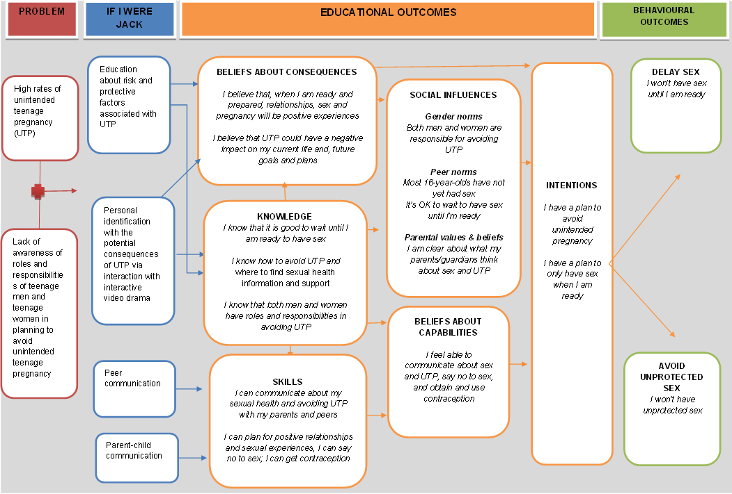
Notes:
[Hand out Theory of Change]
This is the If I Were Jack Theory of Change Model – essentially this diagram shows the logic behind the intervention, and the mechanisms by which the researchers expect the resource to work.
You can see from this that the resource has been designed to target six educational outcomes, which are presented in orange in the centre of the diagram – you’ll note that these relate to the key messages of the resource discussed a moment ago.
Research has shown that these factors can impact on young people’s intention to avoid pregnancy by encouraging them to either delay having sex until they are older or, if they are having sex, to always use contraception.
The film and all the activities that are part of the If I Were Jack resource have been included because they can impact on one or more of these factors.
So for example, the film gives young people the message that unintended pregnancy could be stressful and would likely have negative consequences – thereby attempting to impact beliefs about consequences.

Slide 12
How should the resource be used?
If I Were Jack is designed to fit within the PSHE curriculum for delivery with Year 10/11/S3 students.
Options for delivery include:
  Four 50-60 minute lessons
  Six 35-45 minute lessons
All components of the resource should be delivered to young people as per the instructions provided in the Classroom Materials.
Any questions so far?
Notes:
The resource is designed to fit within the curriculum and should be delivered at Key Stage 4/Level 3/4.
- The resource can be delivered in a way that suits the schools’ normal procedure for RSE/SRE/RSHP. Teachers can choose from the following options:
o Four 50-60 minute lessons (lesson plan A);
o Six 35-45 minute lessons (lesson plan B);
It can be delivered as one or two lessons a week over a number of consecutive weeks or during two half days or one day-long session.
For the purposes of this study, schools must complete the use of the curriculum between October 2018 – December 2018.
- If a teacher would like to deliver the programme in a different way please advise them to speak to the Trial Coordinator for Scotland (Ruth Lewis).
In order to increase the chance that the resource will have the desired impact, all of the different components of the resource should be delivered to young people as per the instructions provided in the classroom materials.
- The resource is non-directive in terms of pregnancy resolution options and is designed to be flexible to fit in with the relationship and sexuality education/personal development policy of all schools across the UK. Thus, the teacher may choose to express their schools particular ethos and policy on personal development when using the resource.
- Does anyone have any questions so far?

Slide 13
If I Were Jack: Ethos
Encourages discussion of various options that may be open to a young person if they experience an unintended pregnancy (i.e. keeping the baby, adoption and abortion) with no suggestion that any one of these options is preferred over others.
Designed to fit within a broad range of school contexts, and has been developed in a range of schools, including faith-based schools.
Notes:
The resource is based on the evidence-based principal that young people have a right to fact-based, comprehensive RSE which allows them to make positive and informed decisions about their relationships and sexual health.
While the resource encourages discussion of the options that may be open to a young person if they experience an unintended pregnancy (i.e. keeping the baby, adoption and abortion) there is no suggestion that any of these options is optimal.
Rather, the resource directs the young person to consider all of the options and their potential outcomes, thereby encouraging reflection on how their decision might be affected by their own individual values. Should they wish, the resource provides an opportunity for the teacher to identify the school’s position on these issues and facilitates young people to discuss the issues with their parents or carers.
If I Were Jack is designed to be used within the context of a comprehensive RSE programme, therefore, restricts its focus to the issue of unintended teenage pregnancy. It does not cover related sexual health issues such as contraception or abortion in detail, as it is assumed that these issues will be covered in more detail in other elements of the RSE curriculum. Some teachers find it useful to use their own resources relating to these issues alongside If I Were Jack, providing such information to students either prior to or in conjunction with, the If I Were Jack programme.
A list of suggested sources of further information on contraception and abortion is available to download in the Teacher Resources section of the If I Were Jack website: www.qub.ac.uk/if-i-were-jack/resources/teachers

Slide 14
Any Questions so far?

Slide 15
How should the resource be used?
Two delivery options:
  Students watch the IVD at a computer on their own. Ear/headphones will be supplied. You should book a computer room/tablets for the first session.
  Can be shown to whole class on a monitor/screen if appropriate/needed. Students can fill in a paper version of the questions that accompany the IVD as they go along. This is for the students benefit only and you should not collect them.
Do not allow students to view the IVD in pairs or small groups.
Please ensure students have enough space so they can answer the questions confidentially.
We recommend that you watch the film in full before using it in the classroom.
Any questions about the IVD?
Notes:
During the first lesson students watch the IVD.
There are two different delivery options for showing the film:
At a computer on their own. Ear/headphones will be supplied by us. You should book a computer room/tablets for the first session.
On a monitor/screen if you feel that would be more appropriate. For example, it might be easier to show on an overhead projector if there are a lot of students in the class with reading difficulties (that way you can explain words if needed). If students watch the film on a monitor/screen they can fill in a paper version of the questions that accompany the IVD as they go along. This is for the students benefit only and you should not collect them.
You should not allow students to view the IVD in pairs or small groups. It is either on individual computers/tablets or as one group on an monitor/screen.
Please ensure that students have enough space in the computer lab or the classroom so that they can answer the questions confidentially. If you think your classroom is too small to allow this, please arrange for this lesson to take place in a larger room if at all possible.
We recommend that you, the teacher watch the IVD in full before using it in the classroom.
Further details relating to film set-up can be found in Classroom Materials, page 6.
Does anyone have any questions about the IVD?

Slide 16
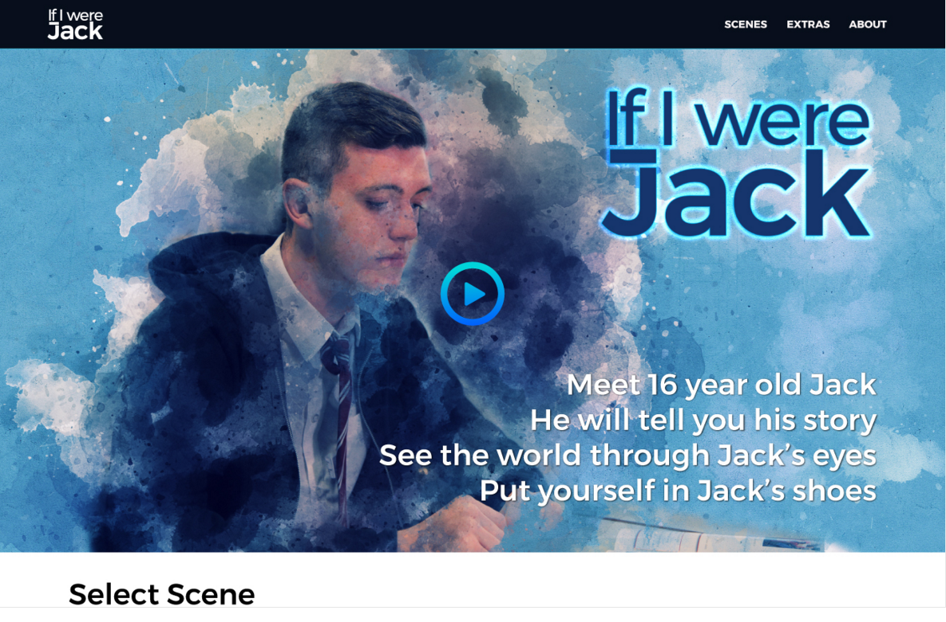
Notes:
We will now watch some of the film.
During the first lesson students watch the film (ideally at a computer on their own).
Note: Using provided Pen Drive, select scene 1 and press play, if you would like to select another example scene please do so
As the film proceeds questions appear on the screen which the young person must answer before continuing.
- Allow the film to play until the first question appears.
- Explain that the film continues like this for around 20 minutes.
- Continue for a further 5 minutes.
- Demonstrate the menu feature and then skip to the last sequence

Slide 17

Notes:
(15 mins)
- Classroom-based activities can be introduced following the viewing of the film. These include group discussions and individual worksheets, which encourage students to think about and plan how to avoid unintended pregnancy.
- Hand out copies of the If I Were Jack Classroom Materials document.
- This document contains two detailed programme delivery options with instructions for teachers and associated worksheets (See pages 4 and 5 of Classroom Materials).
- Go through each of the activities briefly explaining what they are about and what the teacher should do. The instructions for each activity are clearly highlighted in the Classroom Materials. Tell teachers that they should follow these instructions.
- One of the lessons includes a homework exercise (Activity 11) in which students are asked to encourage a parent/carer (or other trusted adult) to watch the film and then answer a number of questions on issues raised in the film. The aim is to provide parents and teenagers with an opportunity to communicate about sex, relationships and pregnancy. An information letter template for sending to parents will also be provided by the Trial Coordinator. This will be posted out by your school in advance; you may wish to check with the schools administration team if that has been done.
- Teachers should remind students that their parents/carers are aware that they are taking part in the If I Were Jack programme and they will be expecting them to bring home the homework exercise.
- Teachers should tell students that, if they prefer, they can do the exercise with another trusted adult other than their parents/carers. This might be a grandparent, older sibling, aunt, uncle or friend. The person must be aged over 18 and someone they know well and trust.
- Any questions about the Classroom Materials?

Slide 18
Delivering the resource
It is really important that you deliver all of the activities outlined in the Classroom Materials.
It is really important that you deliver the activities as instructed in the Classroom Materials.
If for some reason you do make changes, however minor, it is important that they record the change and inform the Trial Coordinator
Notes:
As we’re getting towards the end of the training, I would like to spend a few minutes speaking about how the resource should be delivered.
- The school has agreed to use the resource as part of The JACK Trial. Therefore, it is important that when delivering the resource during this time, teachers follow the instructions which are laid out in the Classroom Materials.
- It is really important that you deliver all of the activities outlined in the Classroom Materials.
- It is really important that you deliver the activities as instructed in the Classroom Materials.
- This is so we can be sure all the students in the study are getting the same resource delivered in the same way.
- If for some reason you do make changes, however minor, it is important that they record the change and inform the Trial Coordinator.

Slide 19
Teacher implementation log & Resource Use questionnaire
The researchers need to ensure that the resource is used as planned during the JACK Trial so they can properly determine if the resource has any impact on rates of unprotected sex.
If it is delivered as planned but does not have the impact intended, they can be sure there’s a problem with the resource.
However, if not delivered as instructed (e.g. leaving out activities or adding other activities) then it is difficult to know if the observed effect is due to use of If I Were Jack, how it was delivered, or both.
If for any reason you make changes, however minor, it’s important that you record the change in the teacher implementation log form and the teacher resource use form and inform a member of the research team.
Notes:
While in ‘real-life’ beyond the research study, the research team acknowledge that teachers would, of course, deliver the resource as they see fit.
For the purposes of The JACK Trial the research team need to ensure that it is used as planned so that they can properly determine if it has any impact on rates of unprotected sex and teenage pregnancy.
If delivered as planned (including all the activities as instructed) but it does not have the impact intended, they can be sure there’s a problem with the resource. However, if not delivered as instructed (e.g. leaving out activities or adding other activities) then it is difficult to know if the observed effect is due to use of If I Were Jack, how it was delivered, or both.
If for any reason you make changes, however minor, it’s important that you record the change in the teacher implementation log form and the teacher resource use form and inform a member of the research team.

Slide 20
Accessing the resource
I have made a single hard copy of the If I Were Jack classroom materials available to you today.
These can be photocopied in the numbers needed for your students or printed directly from the password protected teacher section of the JACK website www.qub.ac.uk/if-i-were-jack/resources/teachers
Your Schools login detail are: INSERT USER NAME & PASSWORD FOR SCHOOL
Notes:
Teachers should be provided with hard copies of the Information for Teachers booklet, Classroom Materials booklet, and If I Were Jack IVD memory stick.
- The IVD and resource materials can be downloaded from the If I Were Jack website www.qub.ac.uk/if-i-were-jack/resources

Slide 21
Accessing the resource
Please test the IVD (both online and using the hard copy) before the first session.
The IVD can be placed on the school’s internal network for viewing if preferable and your IT support can assist. Please do not share the IVD outside the school while the trial is ongoing.
Ask your school IT support to unblock relevant websites (including the Jack website for the IVD) that your students will be required to access. A list of relevant websites is included in the Classroom Materials.
If you encounter difficulties in class accessing the IVD online or via the network, use the pen drive as a back-up to deliver to the group on a large monitor/screen.
Notes:
- Tell teachers that they should test out the film using the online version and hard copy before the first session. They will need to ask the school computer officer/IT technician to ensure that some websites are unblocked before using the resource. A list of these websites can be downloaded from the website.
- They could also ask the technician to put the film on the school network for students to access. If they have any difficulties on the day accessing the film online they would then have a back-up version that they could use. Worst-case scenario they could use their hard copy memory stick to show it on an overhead projector.
- Explain that further information and parents’ materials are also available on the If I Were Jack website.

Slide 22
Please do not share the resource!
It is very important to the research team that none of the If I Were Jack resource materials or access passwords are shared outside of the school while the trial is ongoing.
This is mainly to protect the integrity of the research by ensuring that students in the comparison group schools are not able to receive the intervention until the trial is over.
Notes:
Please note that it is important that none of the resource materials or access passwords are shared outside the school while the trial is ongoing.
This is mainly because we need to make sure that the students in the comparison group schools do not receive the intervention until after the trial is over.

Slide 23




Some advice from students….
Don’t take it too seriously. It’s better if the teacher has a sense of humour as this helps us not feel embarrassed or awkward.
Don’t act embarrassed or awkward. Instead be open, honest and light-hearted about it. That will help us relax and open up.
Be respectful of different points of view and don’t judge us if we say something you don’t agree with.
Adopt a ‘what’s said in the room, stays in the room’ policy and don’t mention anything we say to us or anyone else outside the lesson.
When we are answering the questions in the film or filling in worksheets give us the space we need to do so privately. We probably won’t be honest if we think the teacher is looking over our shoulders.
Notes:
We’d also like to share with you some of the findings from our earlier research during which we asked students about how they would like their teachers to deliver the resource.
Here are some of the things they said:
Any questions?

Slide 24
Case Study Schools Only
You will have been informed if your school is a ‘Case Study School’.
This will mean that some of you lessons may be observed and you may be asked to participate in an interview and focus group to feedback your experience of using the resource with the Trial Co-ordinator.
A small number of pupils in case study schools (X20) pupils will also be asked if they are willing to take part in a focus group later in the year.
Notes:
Explain to teachers that eight schools across the UK will be randomly select as ‘Case Study’ schools.
Ask teachers to complete the Teacher Consent Form if they wish to participate in the research should their school be a case study school. Return completed training evaluation surveys and teacher consent forms (for recording and interview with TC to the TC
A small number of pupils in case study schools (X20) pupils will also be asked if they are willing to take part in a focus group later in the year.
You will provide these teachers with information and consent forms for their pupils to complete and ask teacher to return to School Trial Champion along with ‘Student Engagement Questionnaire’ after completion of delivery

Slide 25
Any further questions?
If you need to clarification after you have had further time to consider you can contact me at:
Add Teacher Trainer Details
Other useful contacts:
Add Trial Coordinator Details for your site

Slide 26
Teacher Consent/ Training Satisfaction
This survey is part of the evaluation of the If I Were Jack programme. It should only take a couple minutes to complete.
Your responses will only be seen by the research team. Your name, school or any other identifying information will not be used in our reporting.
Please complete the questions, seal the sheet in the envelope provided then put it in the collection box.

