Slide 1

Hans Christian Anderson
‘The Snow Queen’

Slide 2
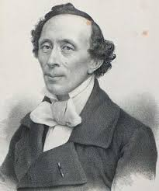
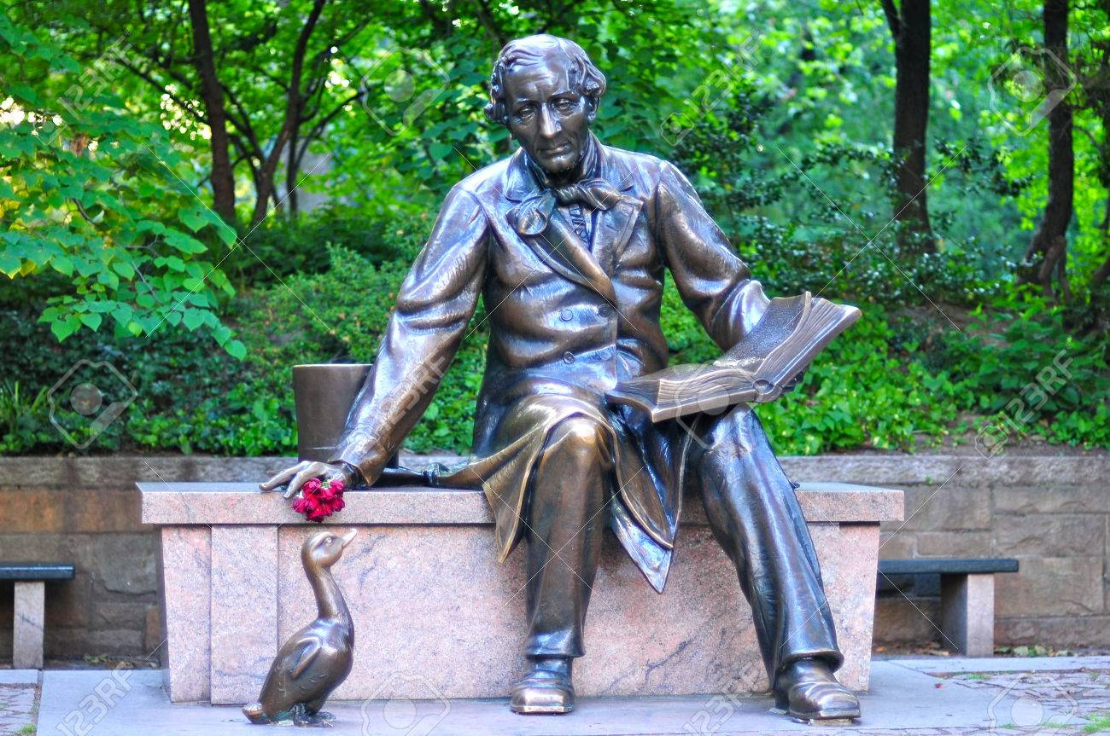
Notes:
The sculpture is in Central Park, New York

Slide 3
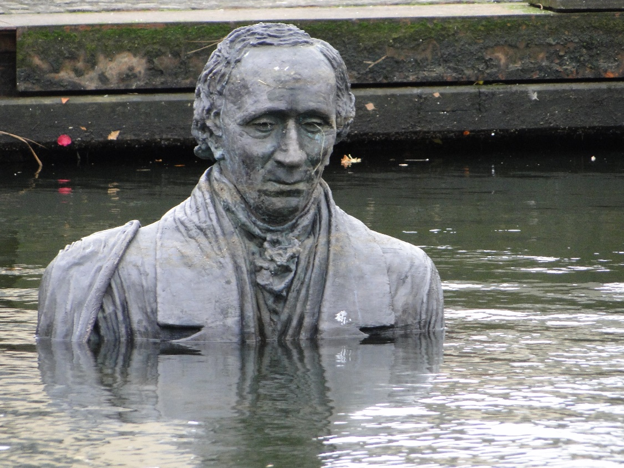
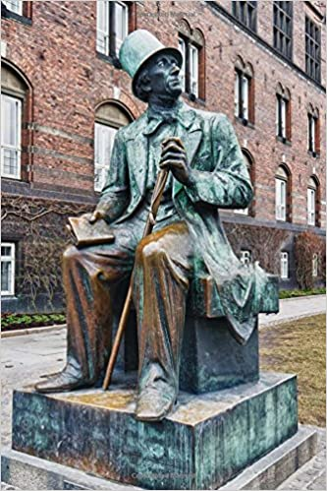

Slide 4
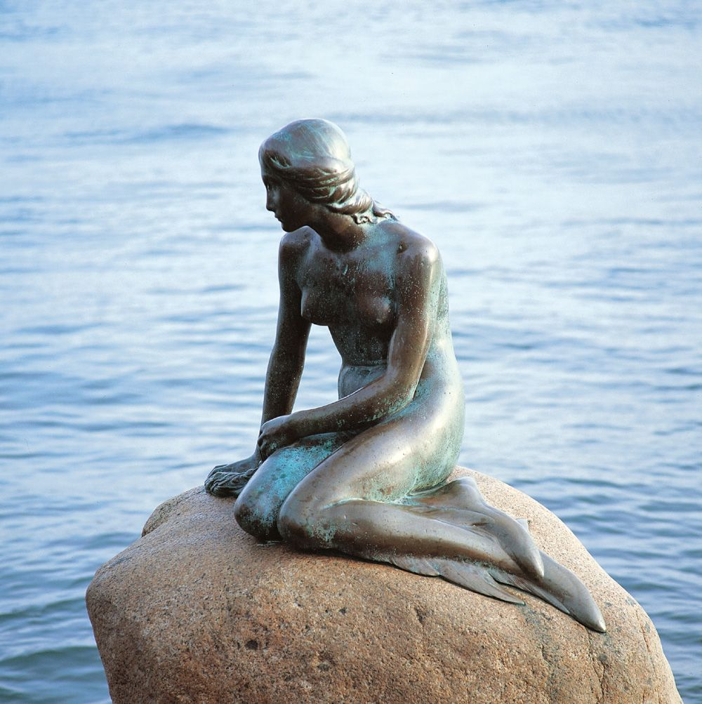
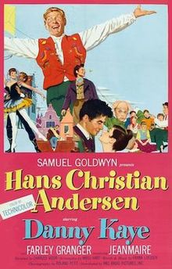
Notes:
Edvard Eriksen’s famous sculpture of The Little Mermaid, Copehagen, based on one of Anderson’s stories.Danny Kaye starred in a 1952 Musical; a romantic and fanciful account of Anderson’s life

Slide 5
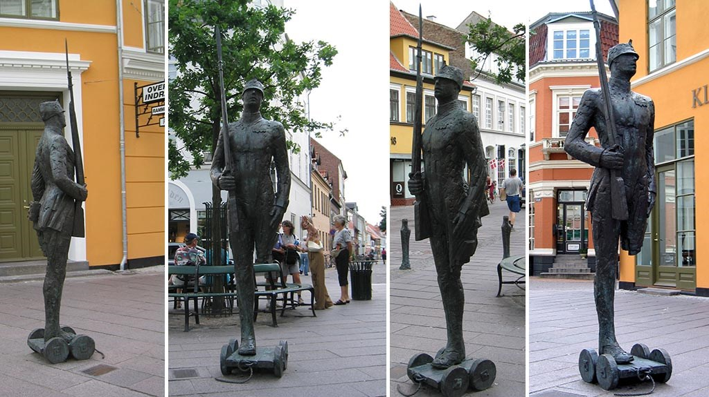
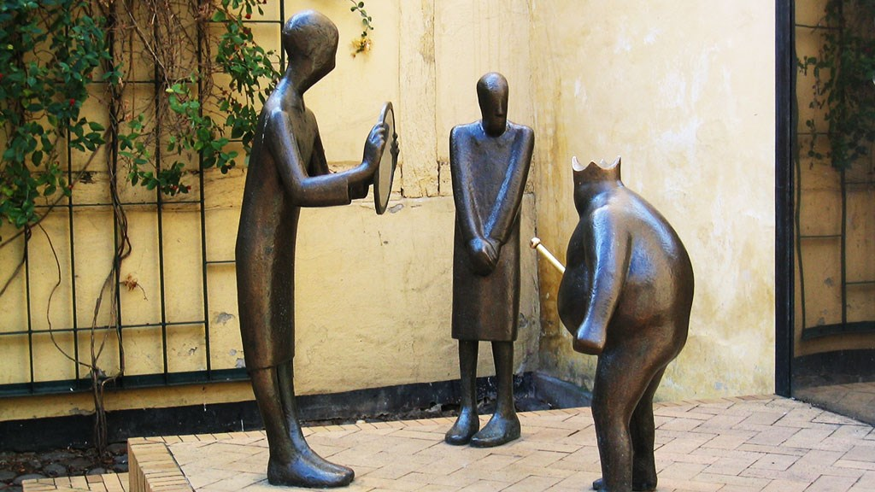
Notes:
The Ttin Soldier, Elev Madsen, 1996; The Emperor’s New Clothes, Keld Mosehol – two of 16 sculptures by various artists in Odense

Slide 6
Hans Christian Anderson
Born, 2 April 1805, Odense, near Copenhagen, died 4 August 1875
Poor parents but helped by Jonas Collin, one of directors of Royal Theatre, Copenhagen, who paid for his schooling, He went to the University of Copenhagen, 1828.
First story published 1829. Became a playwright and novelist
Given a stipend by Royal Family, travelled extensively
Never married, fell in love many times, both women and men
Died of liver cancer

Slide 7
Translations - many available online:
https://andersen.sdu.dk/vaerk/hersholt/TheSnowQueen_e.html
http://hca.gilead.org.il/snow_que.html
https://www.online-literature.com/hans_christian_andersen/972/
https://gutenberg.ca/ebooks/andersen-snowqueen/andersen-snowqueen-00-h.html

Slide 8
A range of illustrations in a slide show format
https://www.youtube.com/watch?v=WEumsB8Vqz8

Slide 9
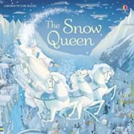
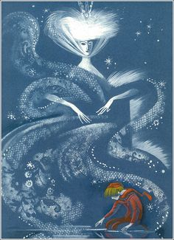

Slide 10

Notes:
Bryan Young, Young Projects.“The flake of snow grew larger and larger; and at last it was like a young lady, dressed in the finest white gauze, made of a million little flakes like stars. She was so beautiful and delicate, but she was of ice, of dazzling, sparkling ice.”
SLIDESHOWDetail of the Snow Queen's Gown of White Bees.
SLIDESHOW“Look, how clever!” said Kay. “That's much more interesting than real flowers! They are as exact as possible; there is not a fault in them, if they did not melt!” https://placesjournal.org/article/fairy-tale-architecture-the-snow-queen
SLIDESHOWDiagram of Swarming White Bees.

Slide 11
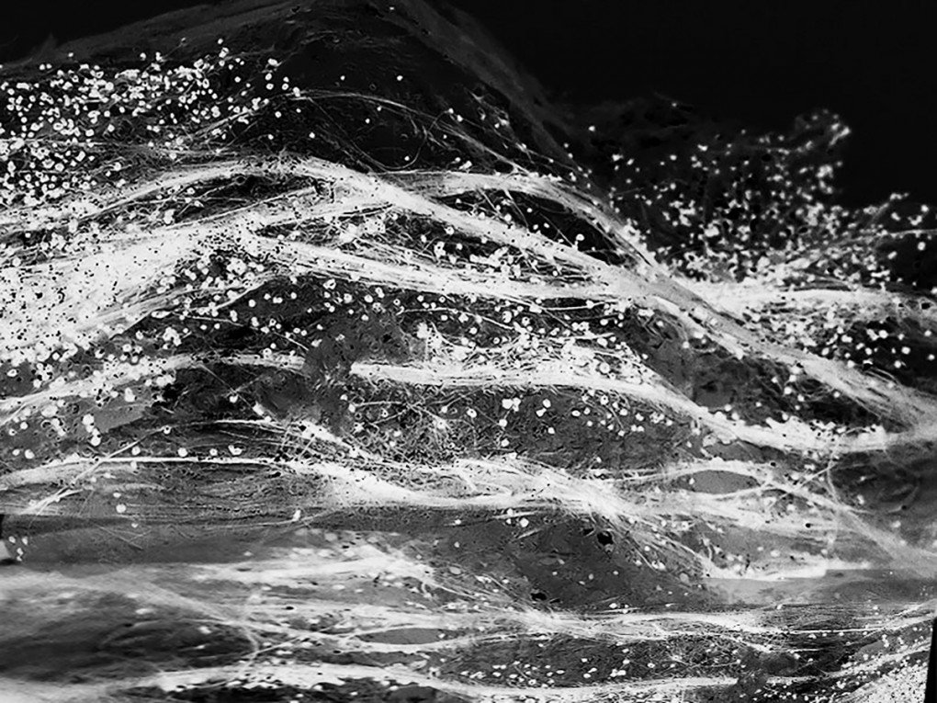
Notes:
Bryan Young, Young Projects. Detail of the Snow Queen's Gown of White Bees. https://placesjournal.org/article/fairy-tale-architecture-the-snow-queen/

Slide 12
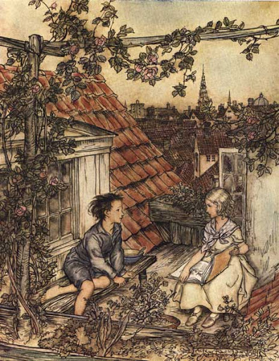
Notes:
Illustrations from the book

Slide 13
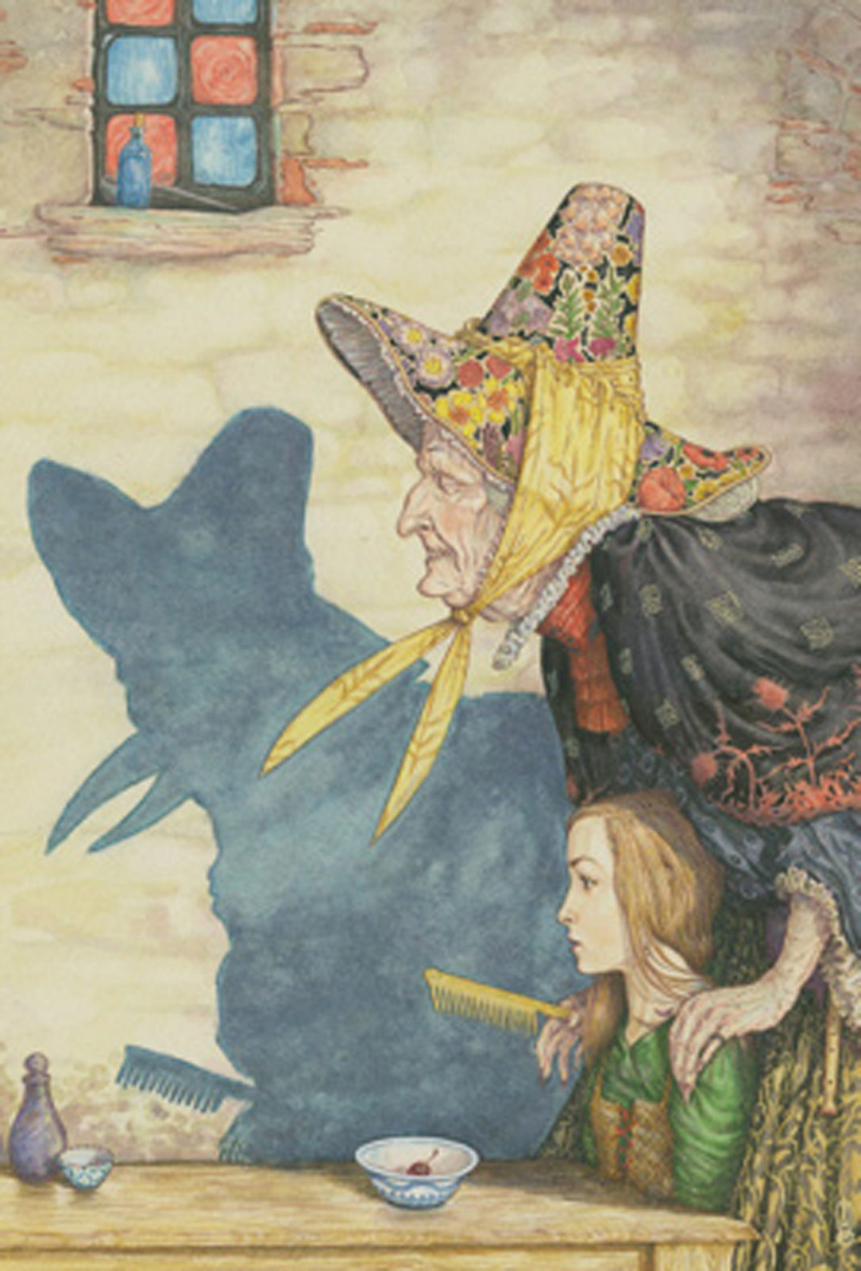
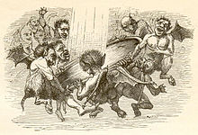

Slide 14
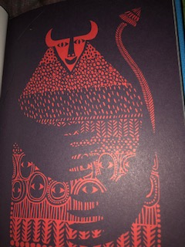
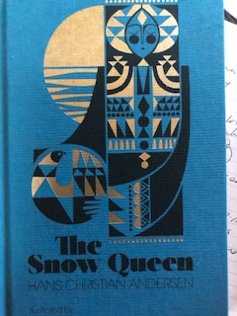
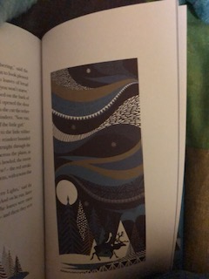
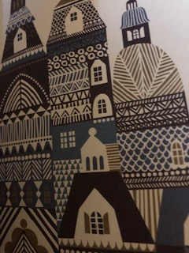
Notes:
Illustrations by Sanna Annukka

Slide 15
Adaptations: ballet
Finnish Ballet
https://oopperabaletti.fi/en/stage24/the-snow-queen-recording/
Greek National Opera https://www.youtube.com/watch?v=5U5S0S1JXl0

Slide 16
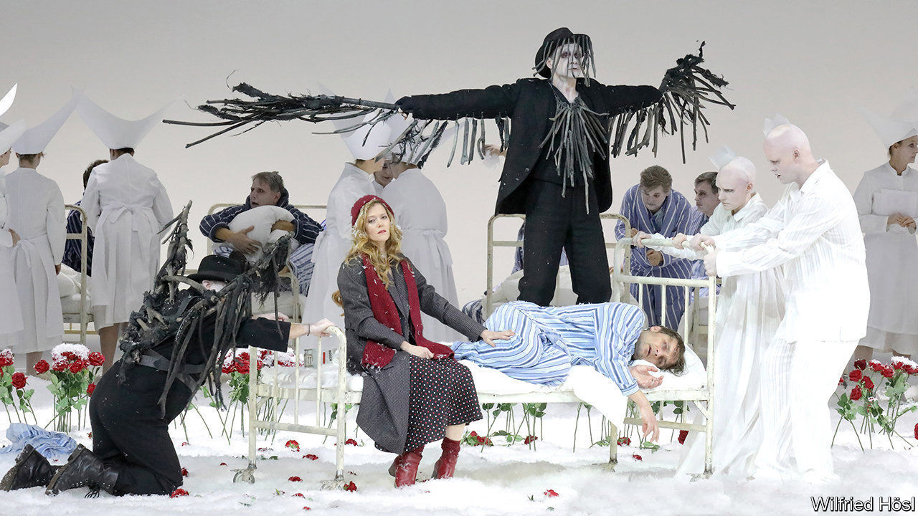
Adaptations: Opera
Hans Abrahamson, Danish Royal Opera, 2019
https://www.youtube.com/watch?v=-KXqv4WVwzU

Slide 17
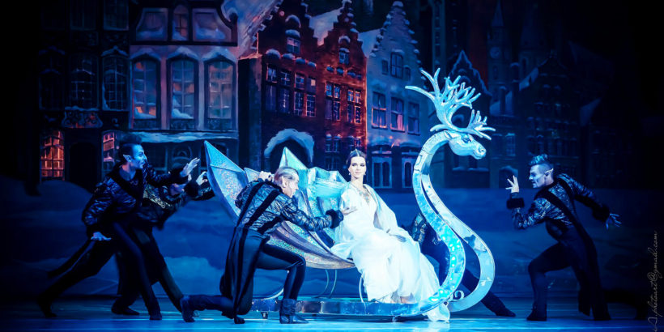
Notes:
National Opera, Ukraine

Slide 18
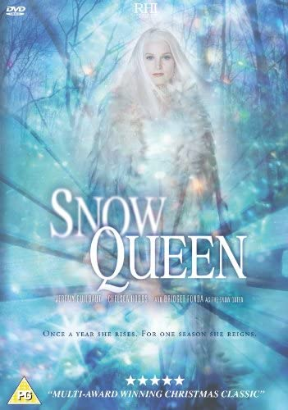
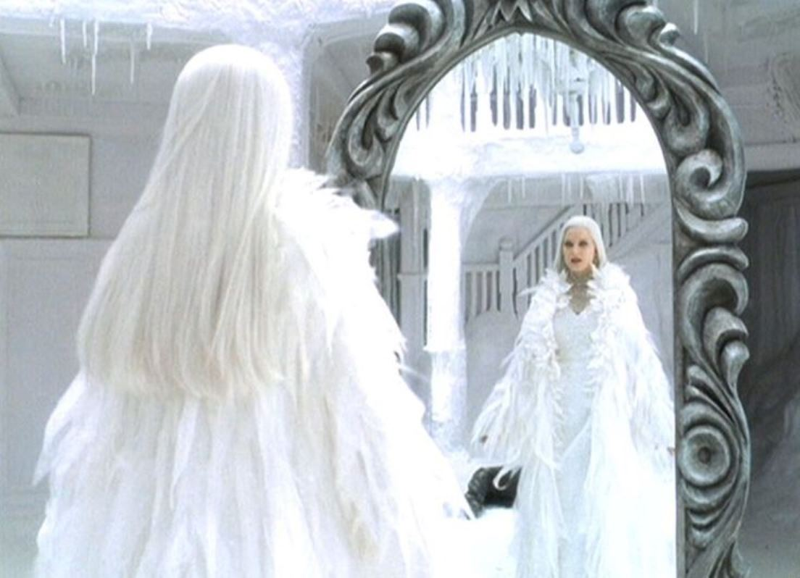
Adaptations: film
Notes:
2002, Dir David Wu, starring Bridget Fonda

Slide 19

Adaptations: Musicals
https://twitter.com/frozenbroadway

Slide 20
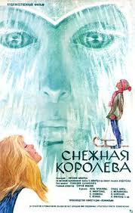
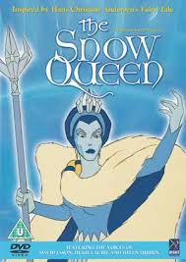
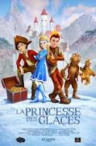
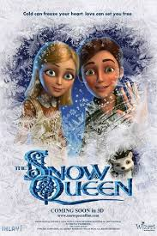
Adaptations: Animations

Slide 21
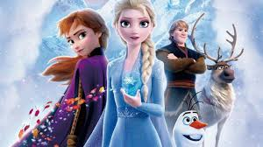
And, the most famous animation: Frozen
hhttps://www.youtube.com/watch?v=hW8XgwBBHrM
ttps://www.youtube.com/watch?v=TbQm5doF_Uc

Slide 22
And there are lots of stories too . . .

Slide 23

Link, Kelly. "Travels with the Snow Queen." Stranger Things Happen. Brooklyn, New York: Small Beer Press, 2001.
Amazon.com: Buy the book in paperback.
SHORT STORY
Kelly Link has made the entire text of this book, including "Travels with the Snow Queen", available online for reading free of charge. Go to Jelly Ink Press: Stranger Things Happen.

Slide 24

Donoghue, Emma. "The Tale of the Brother." Kissing the Witch: Old Tales in New Skins. New York: Harper Collins, 1997.
Amazon.com: Buy the book in hardcover or paperback.
SHORT STORY

Slide 25
‘The Snow Queen’ It’s only a fairy tale . . .
‘Though fairy tales may appear simple, they demonstrate ‘chaotic’, ‘highly ambiguous’ symbolic codes, inviting ‘diverse responses’ . . . ’
(Haase, 193a, p.235, cited in Pauline Greenhill, 2016, Team Snow Queen: Feminist Cinematic ‘Misinterpretations’ of a Fairy Tale. Studies in European Cinema, 13(1), pp.32-49. https://www.tandfonline.com/doi/abs/10.1080/17411548.2016.1140491?src=recsys&journalCode=rseu20
Anything goes in this ancient – or postmodern – fairy tale world.(Brian Young (2015) ‘Fairy Tale Architecture: ‘The Snow Queen’.
https://placesjournal.org/article/fairy-tale-architecture-the-snow-queen

Slide 26
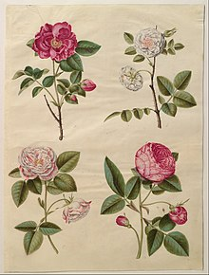
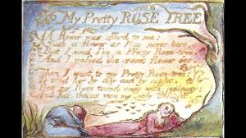
Notes:
Rose symbolism: Hans Simon Holtzbecker: Rosa gallica, gouache, c. 1650 (Statens Museum for Kunst, Copenhagen).
The vivid red, semi-double Rosa gallica was "the ancestor of all the roses of medieval Europe".^{[1]}
Wiliam Blake, ‘My Pretty Rose Tree (Songsof Innocence and Experience, 1789)

Slide 27
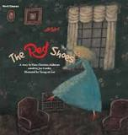
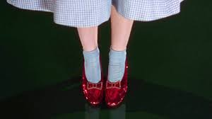

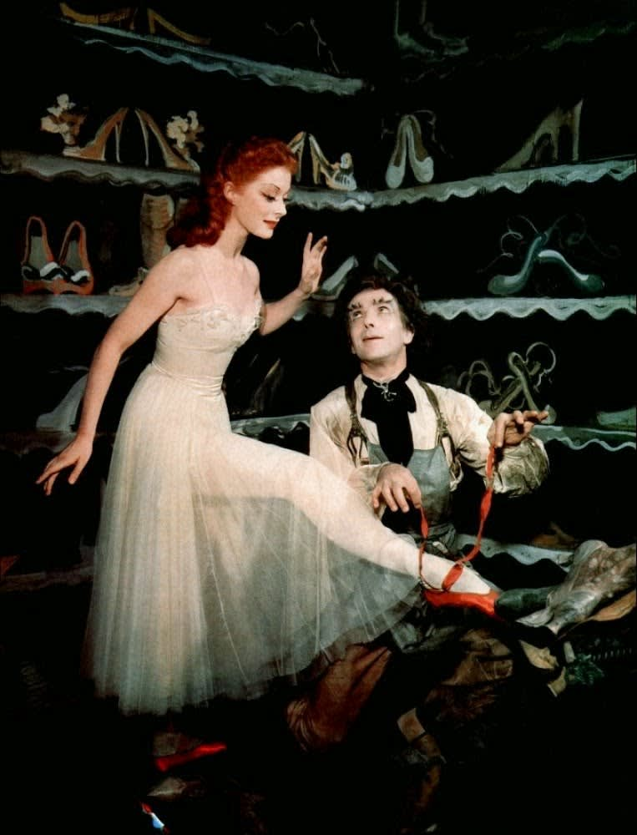
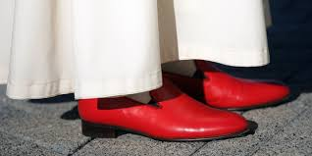
Dorothy’s Iconic Ruby-Red Slippers
on sale for $6million, 2018
Notes:
Cover from Hans Christian Anderson’s ‘The Red Shoes’ (1845); Dorothy’s red shoes in The Wizard of Oz (1939); Moira Shearer in the film, The Red Shoes (1948); the papal red shoes, The contemporary Red Shoe Movement

